Slide 1

ACCL23-12 Interview
Presenter: Eric Viklund

Slide 2
Personal Introduction
Name: Eric Viklund
Contact:
ericviklund2023@u.northwestern.edu
+1(860)834-5008
Education:
B.S. Physics from University of Connecticut
Currently PhD candidate at Northwestern University
Research Experience:
SRF Cavity Manufacturing Technology
Electropolishing
Mechanical Polishing
Nb₃Sn Cavity Manufacturing via Tin Vapor Diffusion
Surface Analysis
Scanning and Tunneling Electron Beam Microscopy
Focused Ion Beam Milling for Sample Preparation and 3D Imaging

Slide 3
Outline
Research Experience
Study on the Electrochemical Polishing Process Applied to Niobium SRF Cavities
Development of a Mechanical Polishing Process for Nb₃Sn Coated SRF Cavities
Research Proposal
Cost Reduction Methods for Niobium SRF Cavity Fabrication
Study on the HF-Free Bipolar Electrochemical Polishing Method

Slide 4
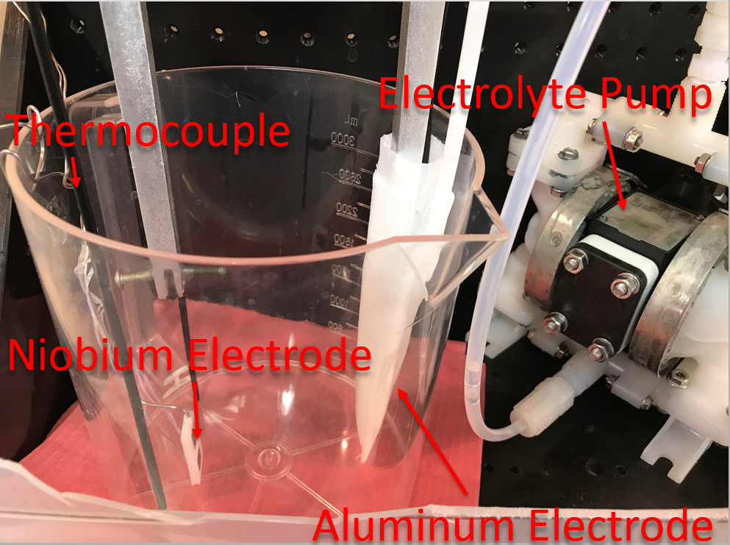
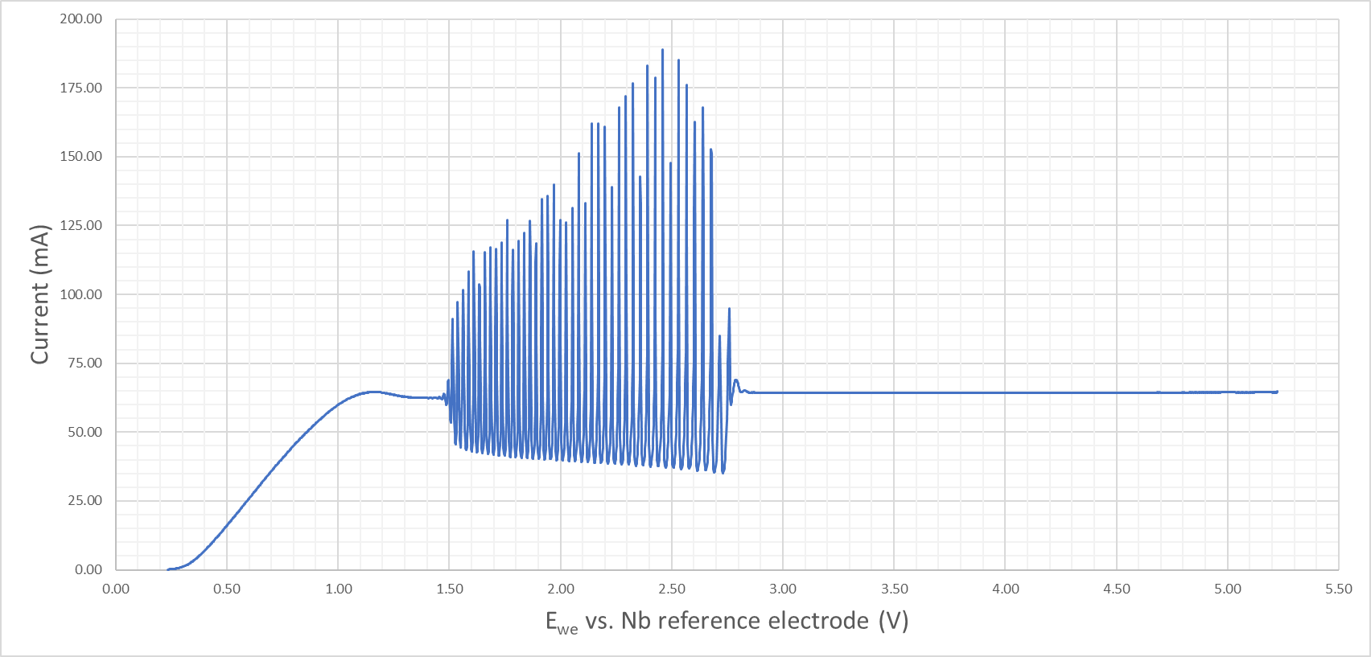
Electropolishing Study
Defects such as etching and pitting were discovered in nitrogen doped niobium cavities.
It was determined that a better understanding of EP was necessary to understand and prevent these defects.
Niobium samples are electropolished using different parameters.
Applied voltage
Electrolyte temperature
Nitrogen doping

Slide 5
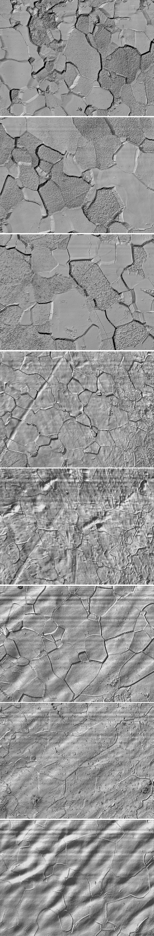
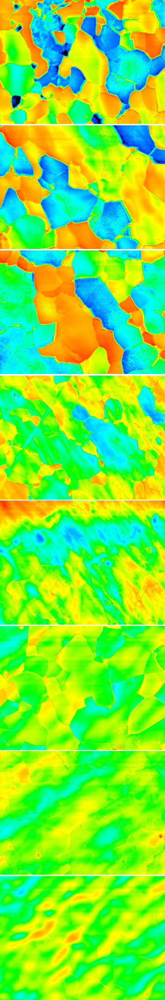
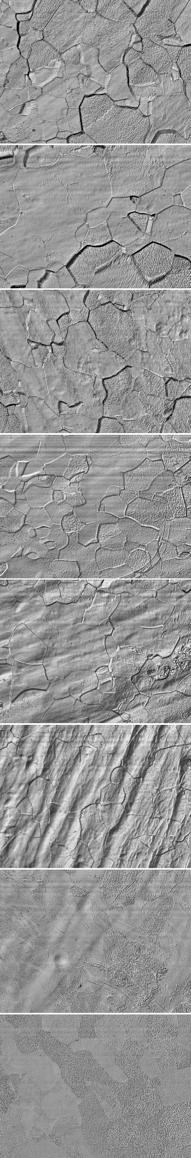
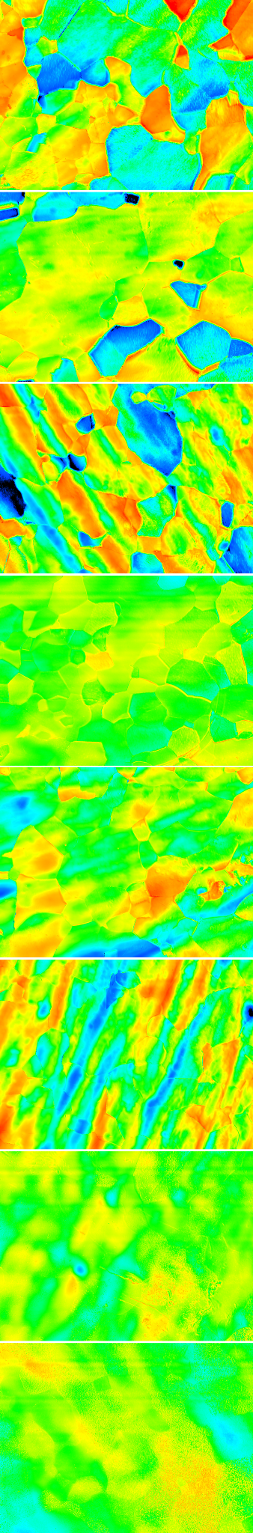
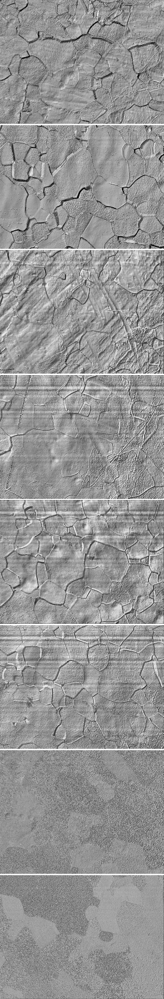
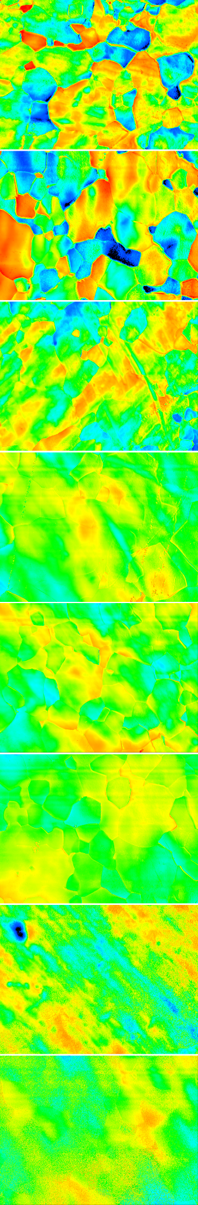
Surface Analysis of Electropolished Samples
The sample study showed that the etching was caused by low polishing voltage.
Nitrogen doping shows no effect on etching.
Temperature has no direct impact but can cause an ohmic voltage drop in the electrolyte due to high currents.
Cathode was redesigned and voltage increased to prevent etching in cavities.
Voltage
0.5
0.6
0.7
0.8
0.9
1.0
1.1
1.2
Voltage
0.5
0.6
0.7
0.8
0.9
1.0
1.1
1.2
Undoped
Undoped
Nitrogen Doped
Nitrogen Doped
Nitrogen Doped Cold EP
Nitrogen Doped Cold EP

Slide 6
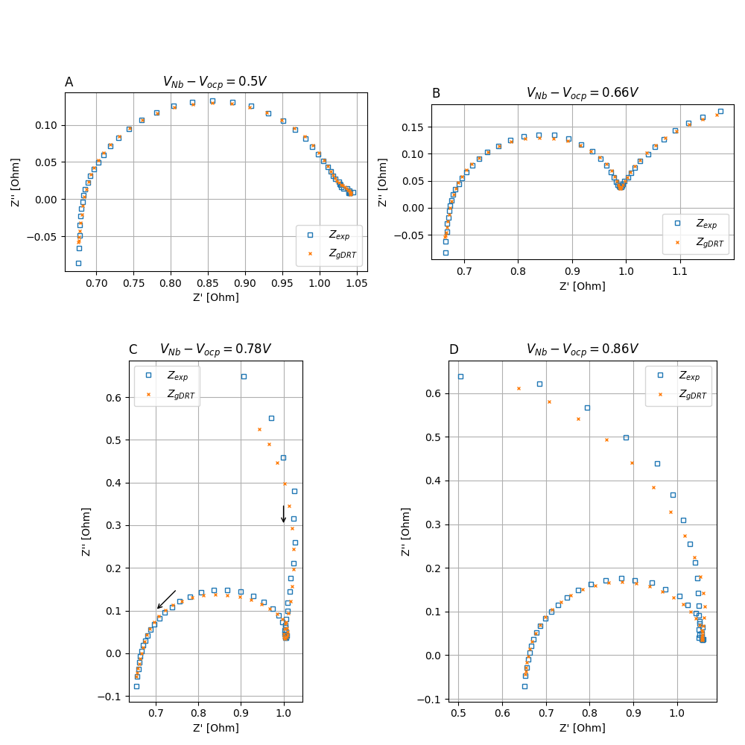
Electrochemical Impedance Spectroscopy
To understand the cause of etching in cavities, electrochemical impedance spectroscopy (EIS) can provide more information on the chemical processes on the electrode surface.
A small alternating voltage is applied to the electrode to measure the complex electrical impedance spectrum.
This spectrum can show how the surface chemistry changes for different applied voltages.

Slide 7
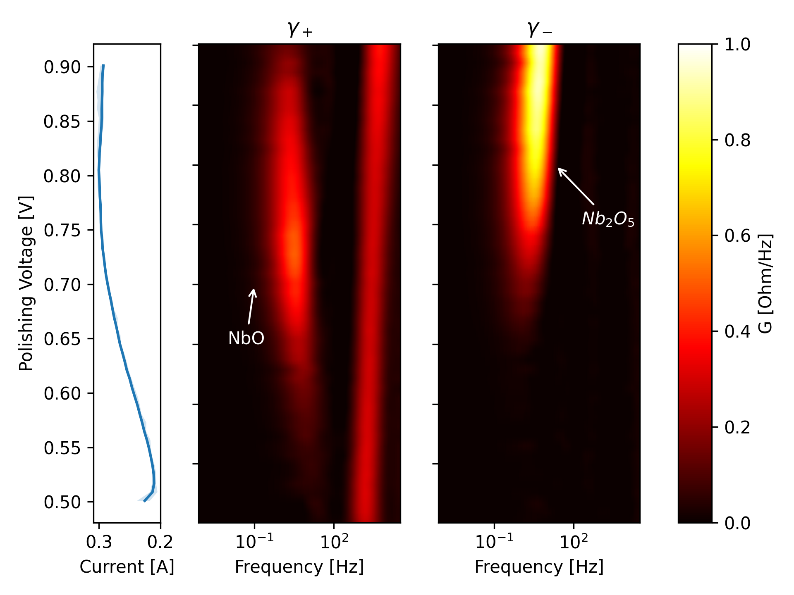
Data Analysis Using Distribution of Relaxation Times Fitting
The distribution of relaxation times de-convolves the impedance spectrum revealing distinct peaks that correspond to chemical processes.
At low voltage only the electric double layer contributes to the impedance.
As the voltage is increased a second contribution from the oxide film is measured.
The oxide film contribution develops further indicating the transition from a thin partial oxide layer to a thick oxide layer.

Slide 8
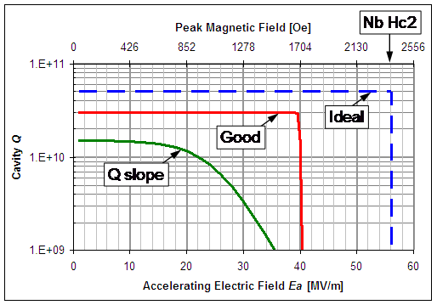
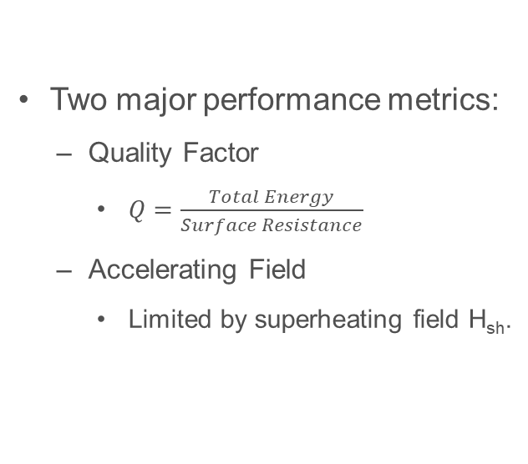
Quantifying SRF Cavity Performance
Two major performance metrics:
Quality Factor
$Q=\frac{Total Energy}{Surface Resistance}$
Accelerating Field
Limited by superheating field H_{sh}.
H_{sh}

Slide 9
Beyond Niobium – Nb₃Sn Thin Film Cavities
 | Nb | Nb₃Sn | Difference
Q_{@4K} | ~10⁹
E_{max} | 50 MV/m

Slide 10
Beyond Niobium – Nb₃Sn Thin Film Cavities
 | Nb | Nb₃Sn | Difference
Q_{@4K} | ~10⁹ | ~10¹⁰ | 10x
E_{max} | 50 MV/m | 100 MV/m | 2x

Slide 11
Beyond Niobium – Nb₃Sn Thin Film Cavities
 | Nb | Nb₃Sn | Difference
Q_{@4K} | ~10⁹ | ~10¹⁰ | 10x
E_{max} | 50 MV/m | ~20 MV/m | 2x

Slide 12
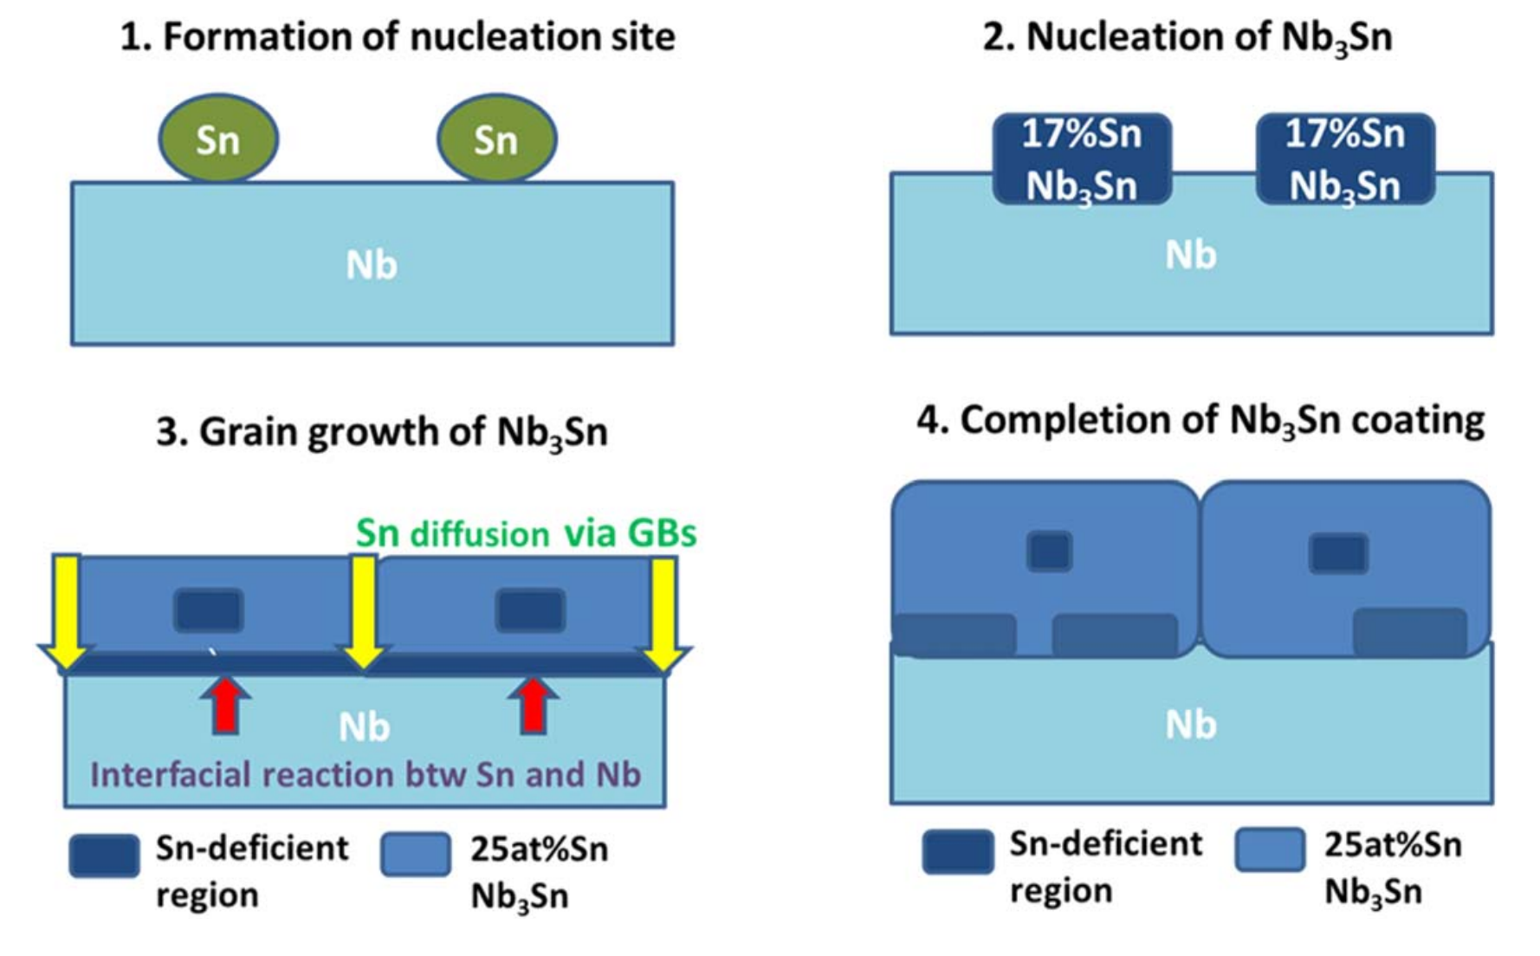
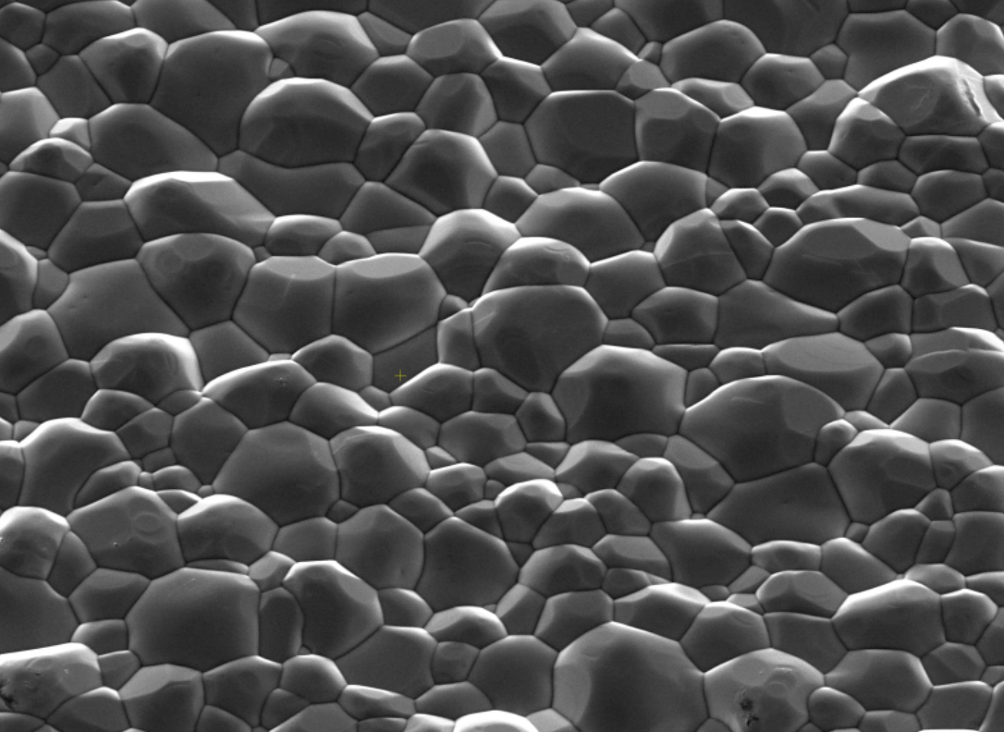
Challenges of Nb₃Sn Cavity Fabrication
Lee, Jaeyel, et al. Superconductor Science and Technology 32.2 (2018): 024001.
Viklund, Eric, et al. Superconductor Science and Technology 37.2 (2024): 025009.
Nb₃Sn is brittle.
Stoichiometry is important.
Nb₃Sn cannot be electropolished.
3 μm

Slide 13
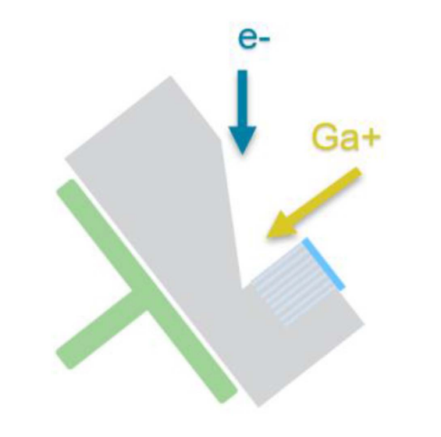
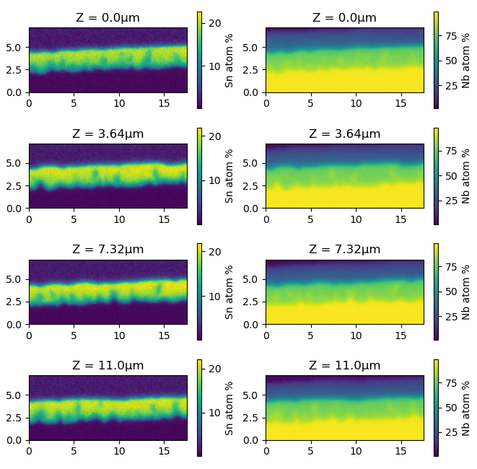
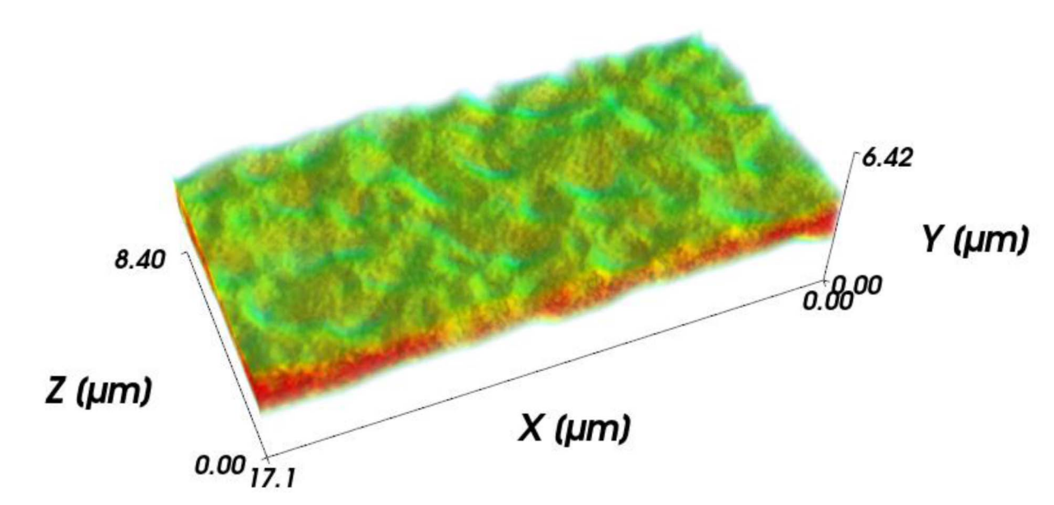
Investigation of Sn Deficient Regions Using 3D Tomography
Pt Cap
Y
Nb₃Sn
Bulk Nb
Z
X
Viklund, E., et al. IEEE Transactions on Applied Superconductivity 33.5 (2023): 1-4.

Slide 14
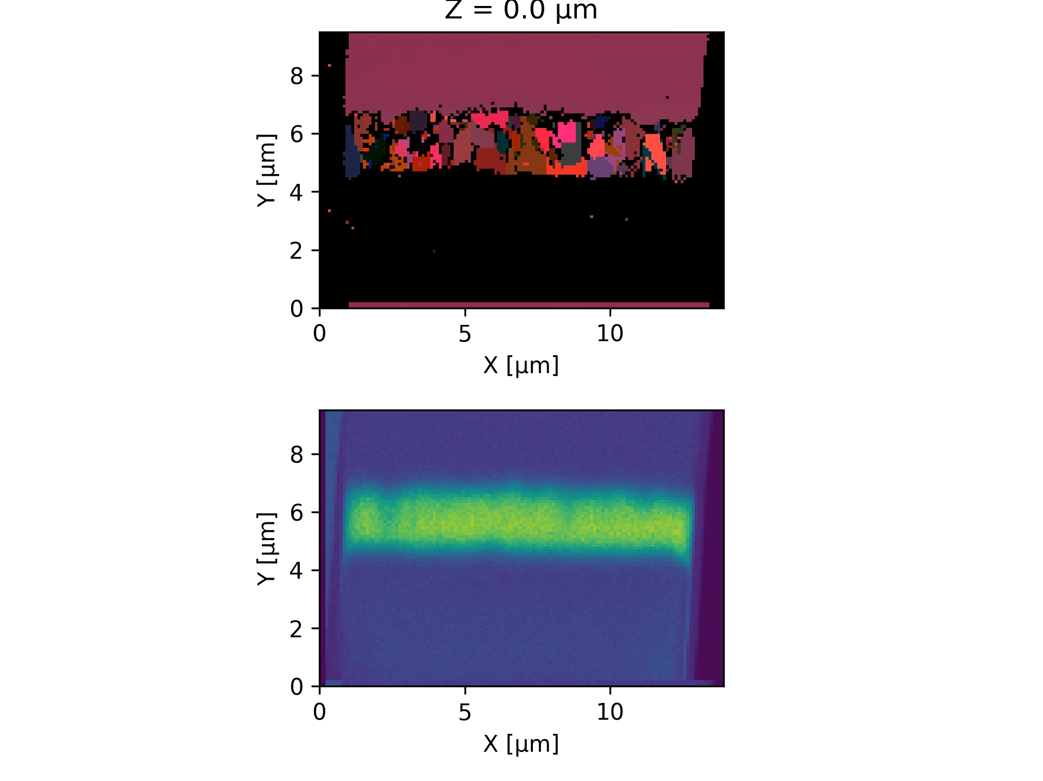
Combined 3D EDS and EBSD
EDS shows Sn distribution within the film.
EBSD shows the grain structure of the film.
Sn deficient are shown to be intra granular as suggested by the Sn nucleation model.

Slide 15
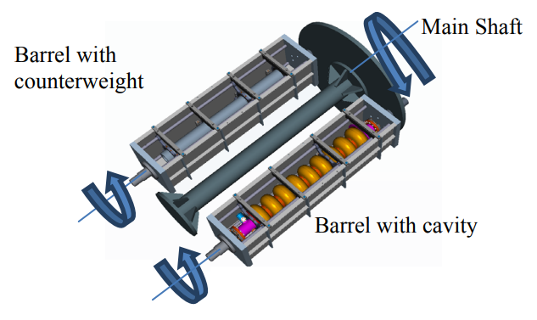
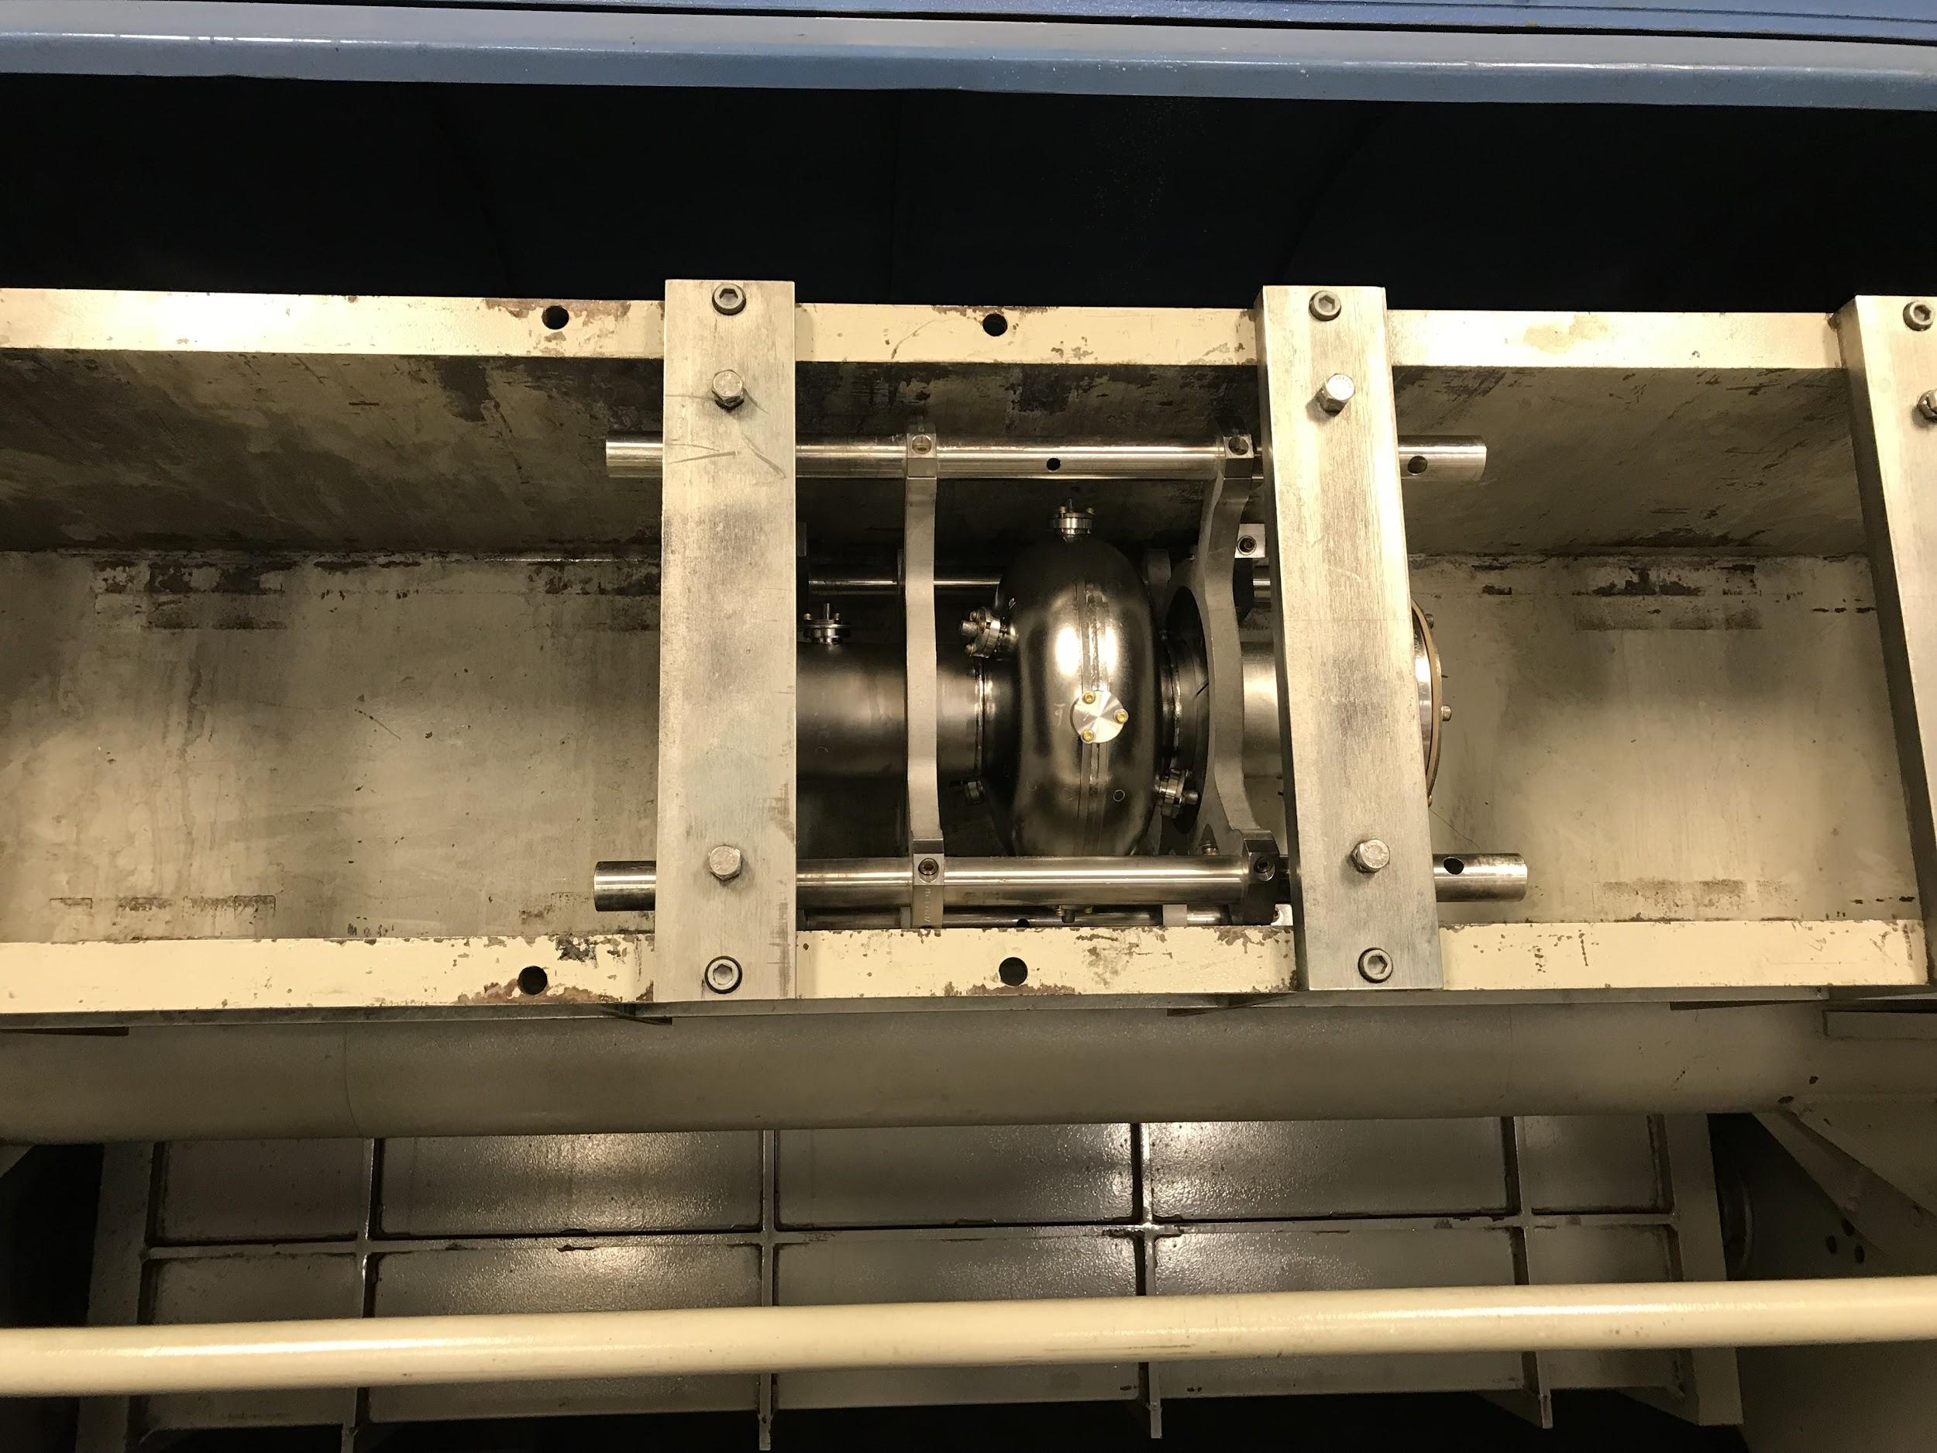
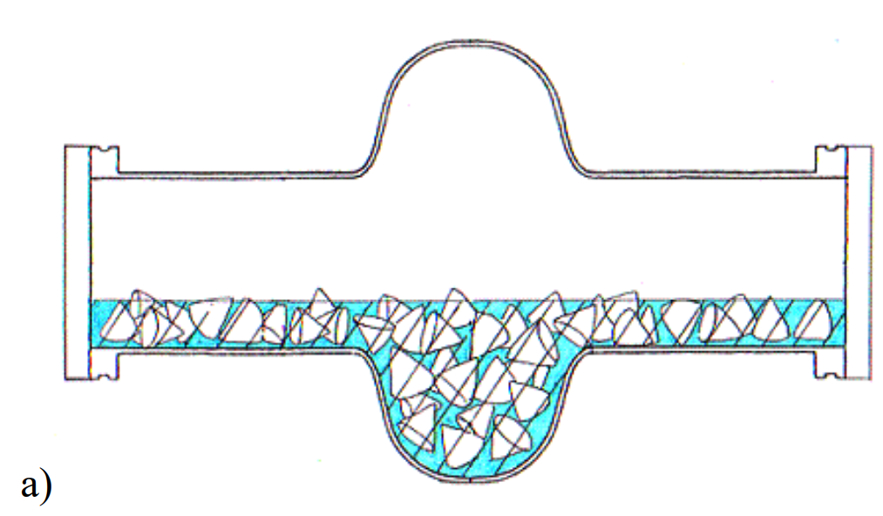
Centrifugal Barrel Polishing (CBP)

Slide 16
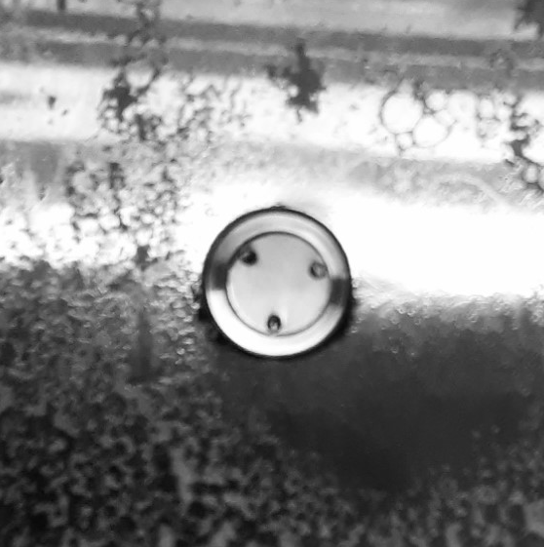
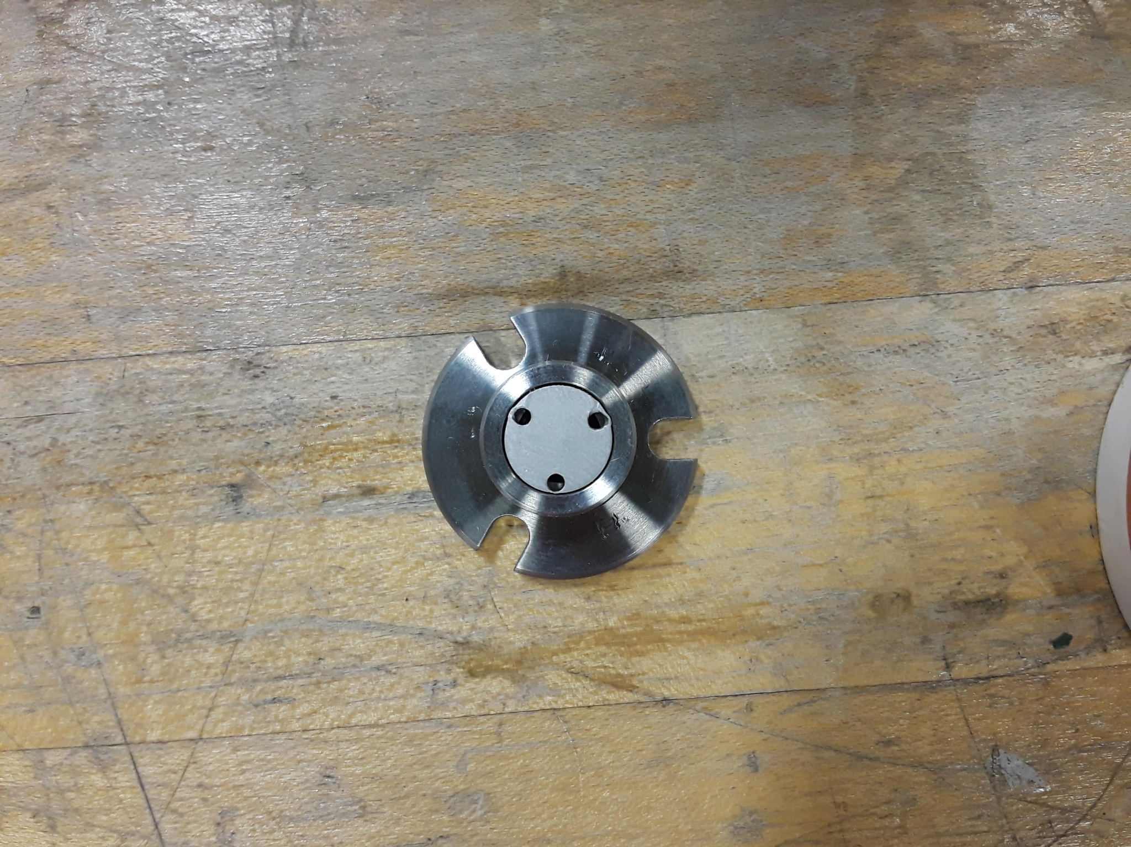
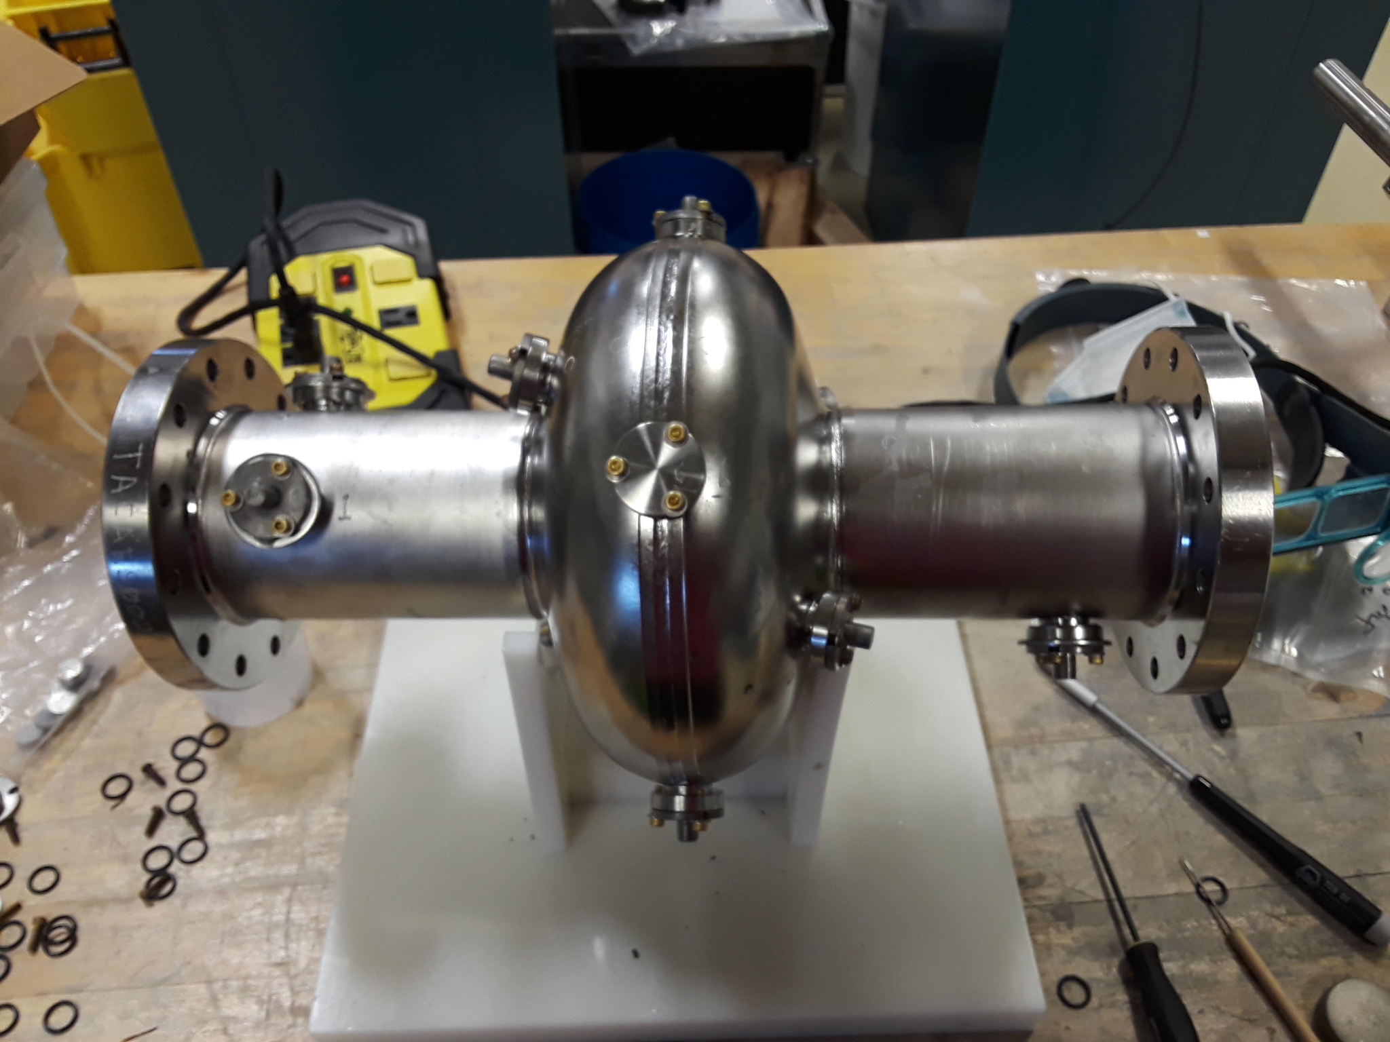
Nb₃Sn Sample Polishing Using a Coupon Cavity
1 cm Nb₃Sn coated sample
Internal View

Slide 17
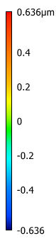
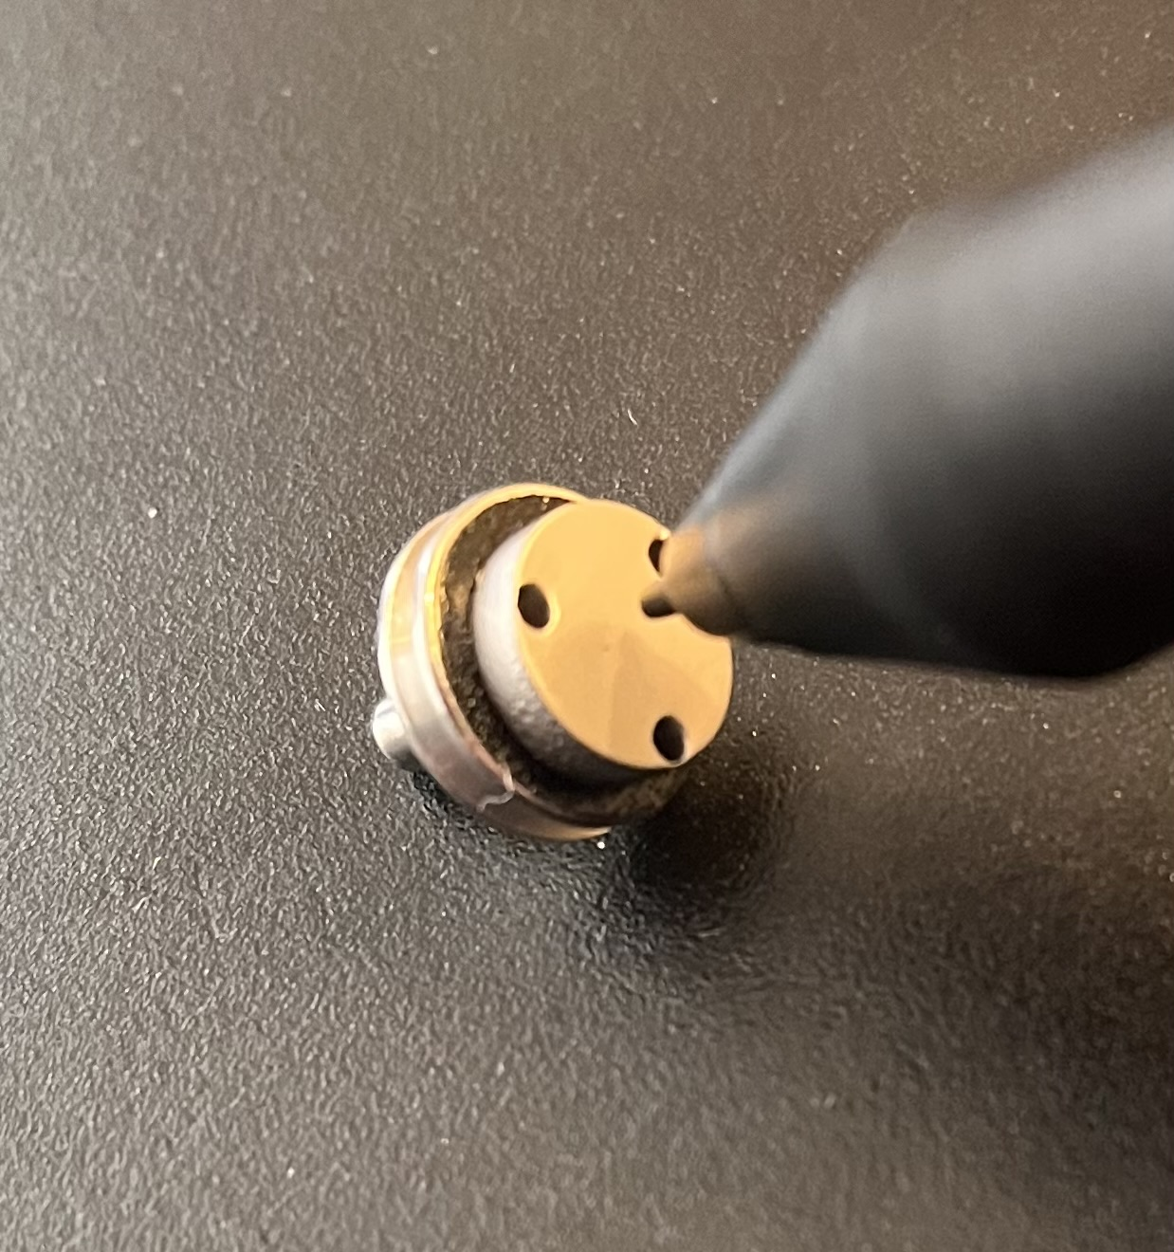
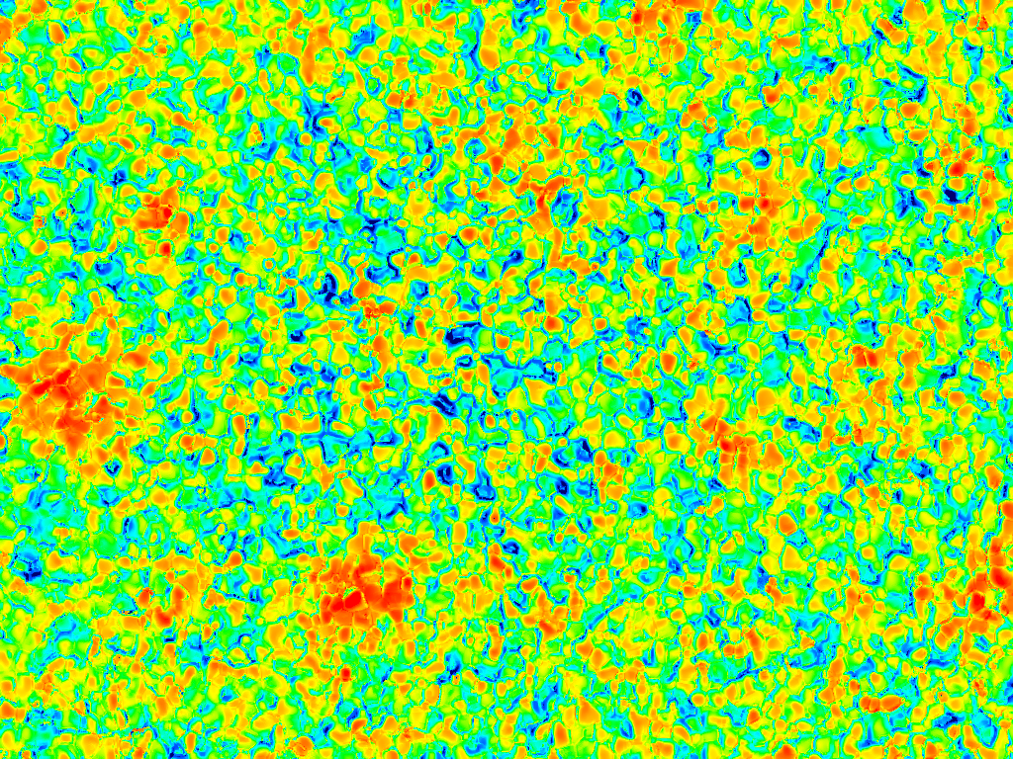
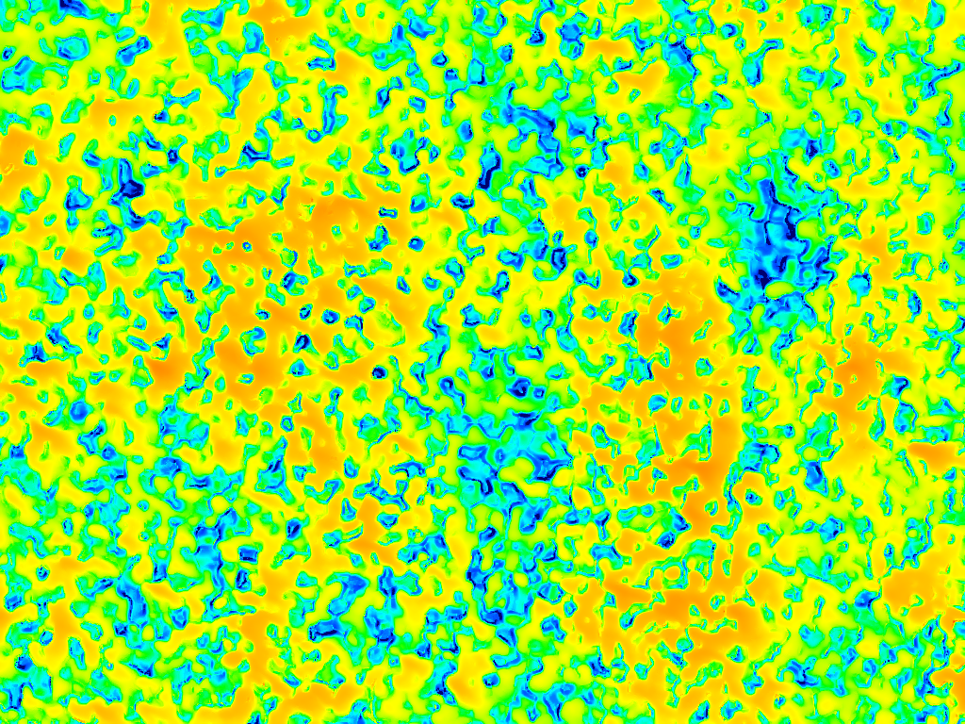
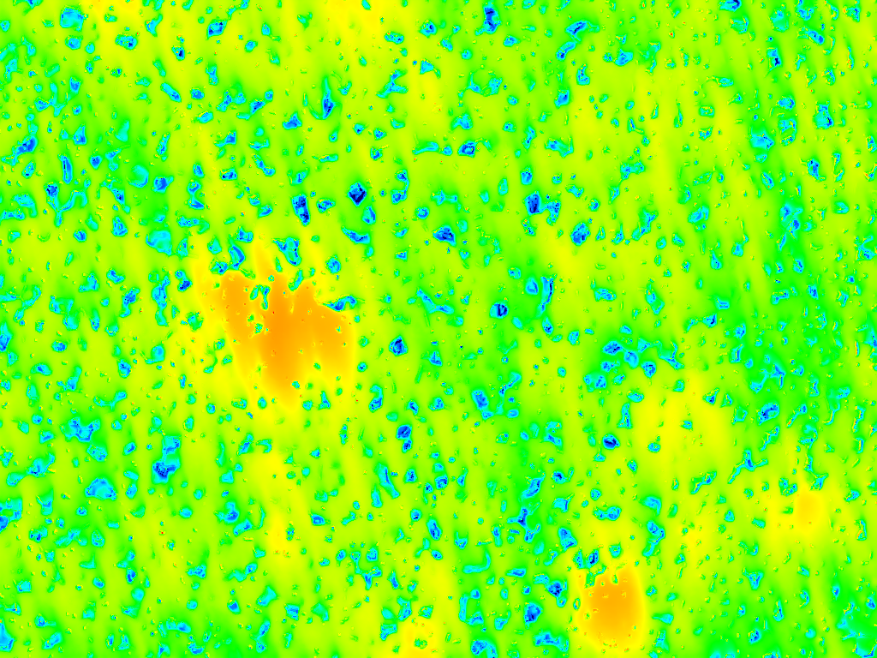
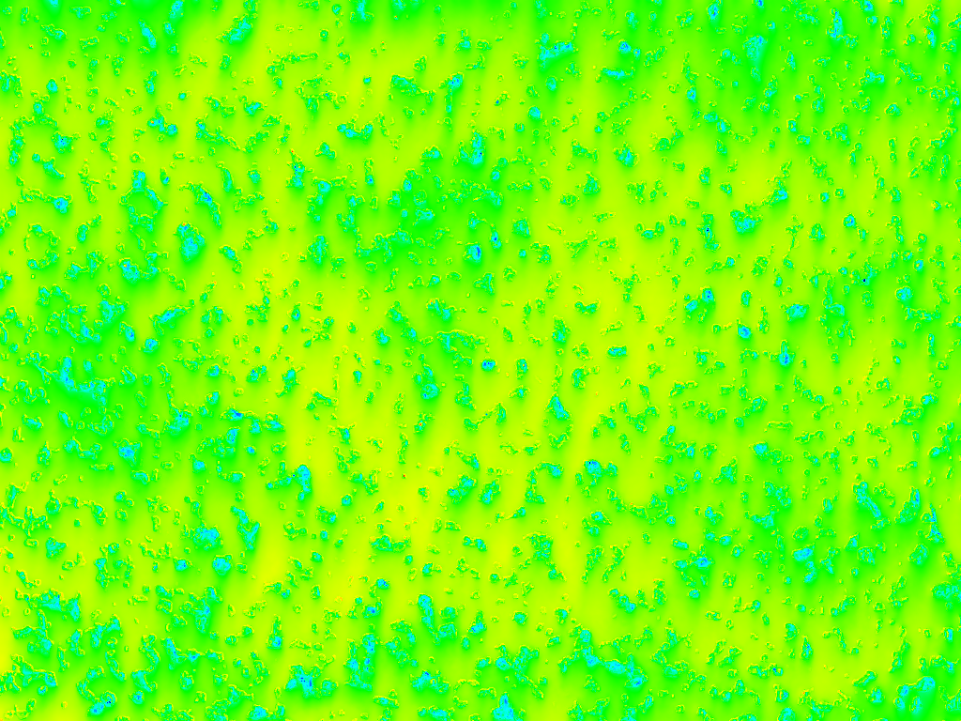
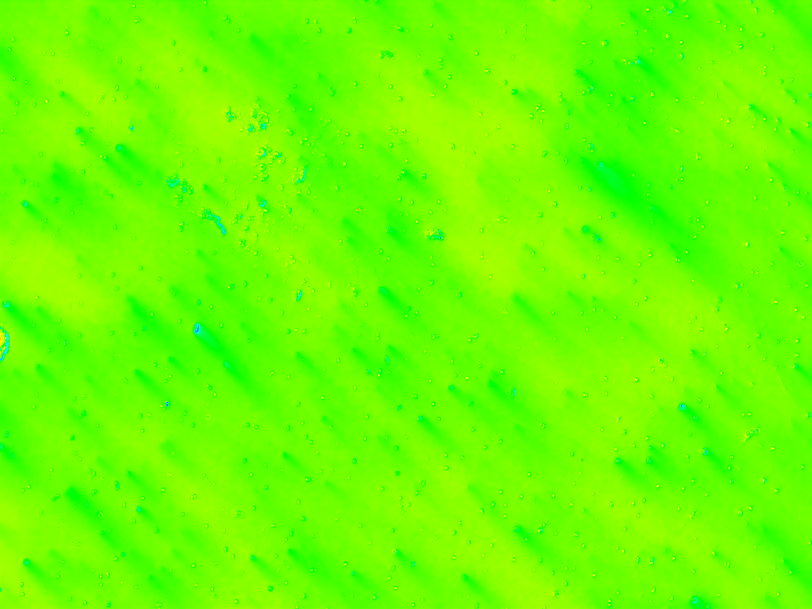
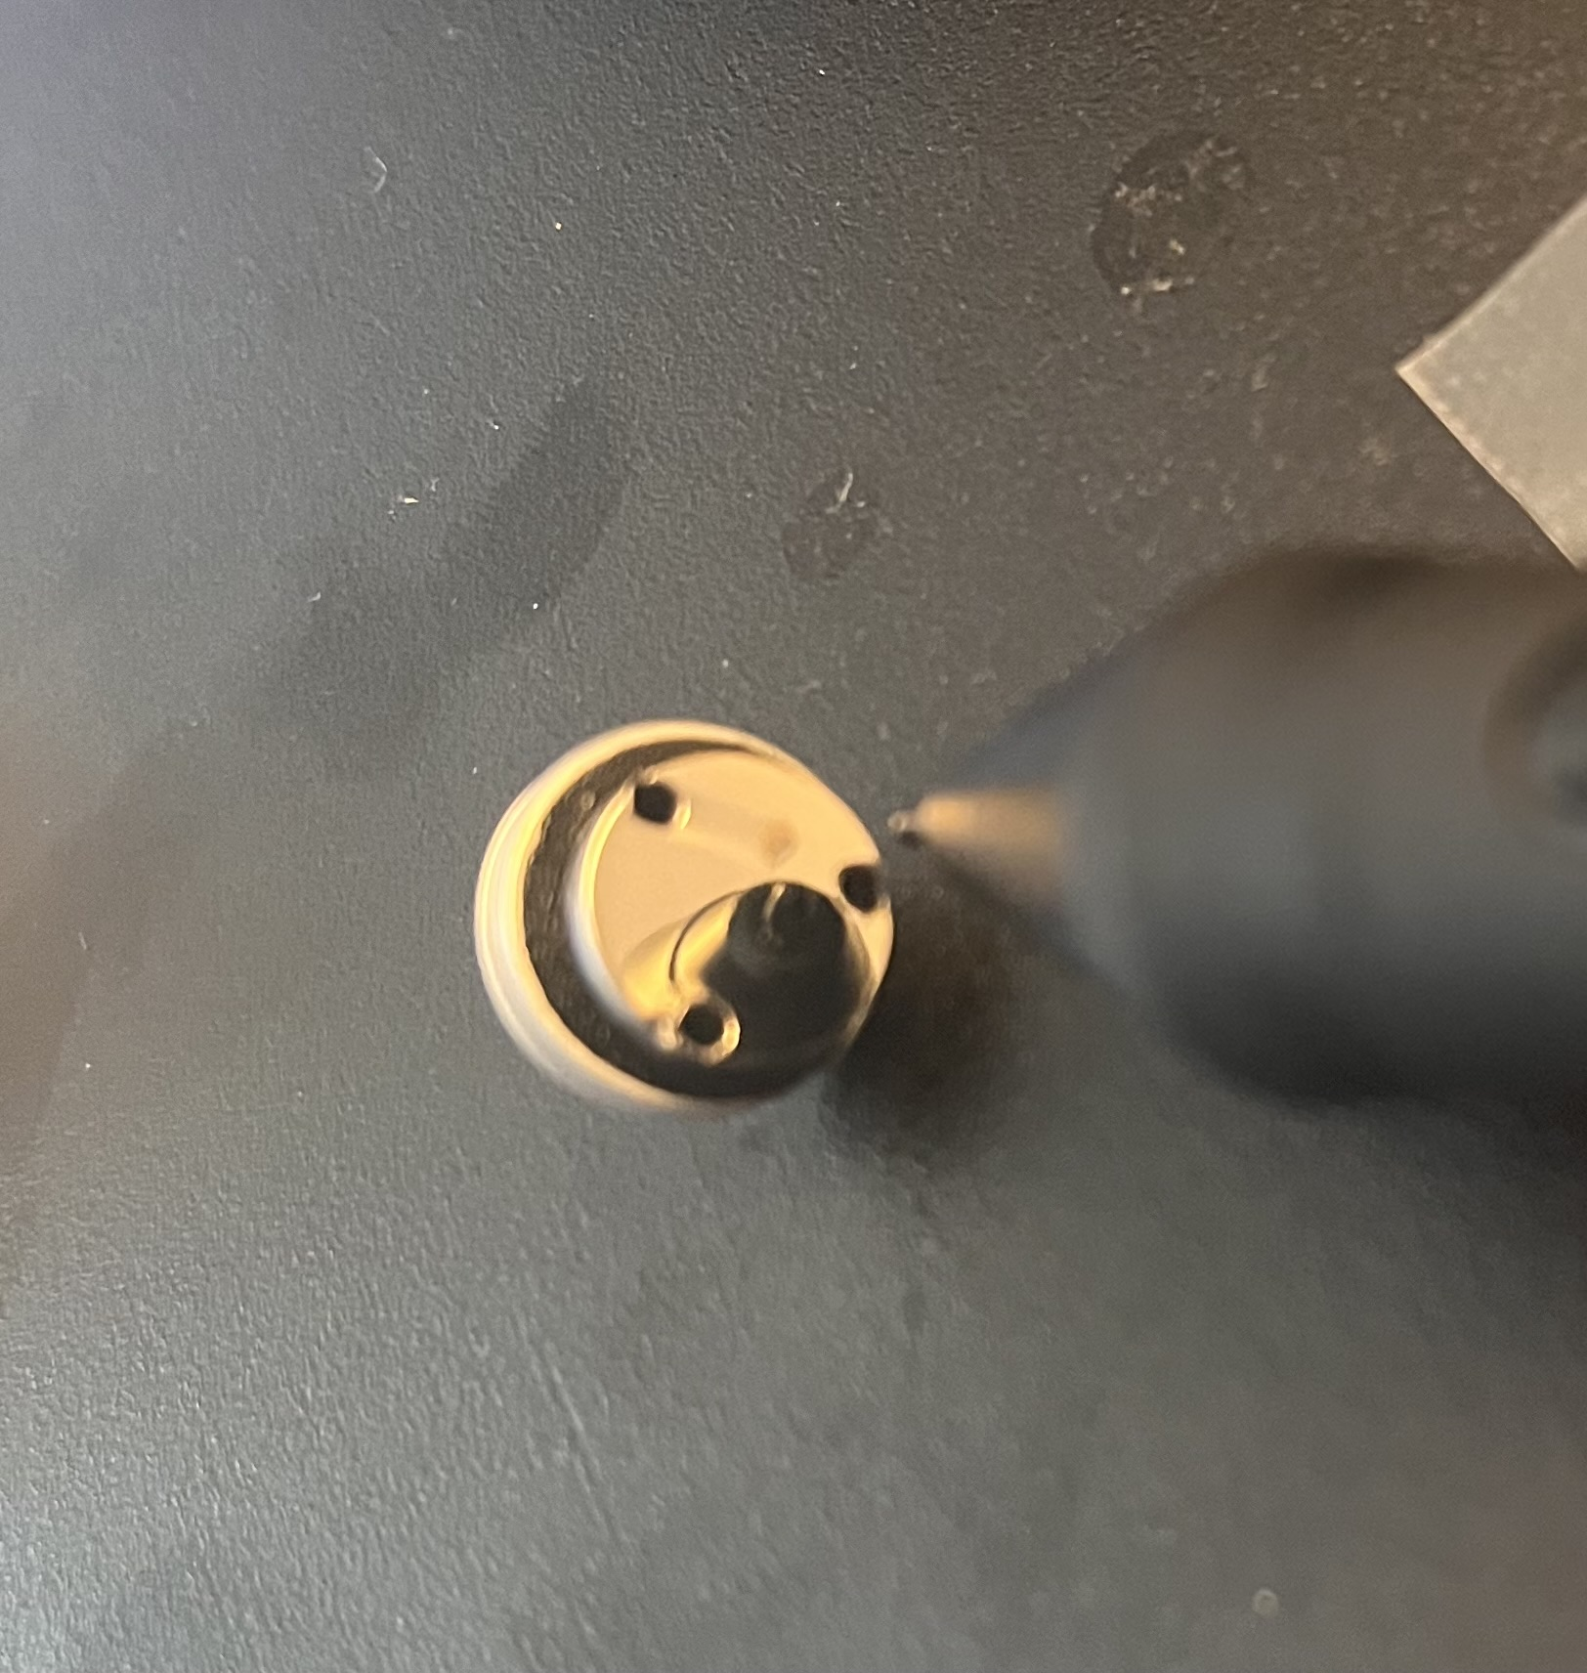
0 hours
2 hours
4 hours
6 hours
8 hours
Viklund, Eric, et al. Superconductor Science and Technology 37.2 (2024): 025009.
86 μm

Slide 18
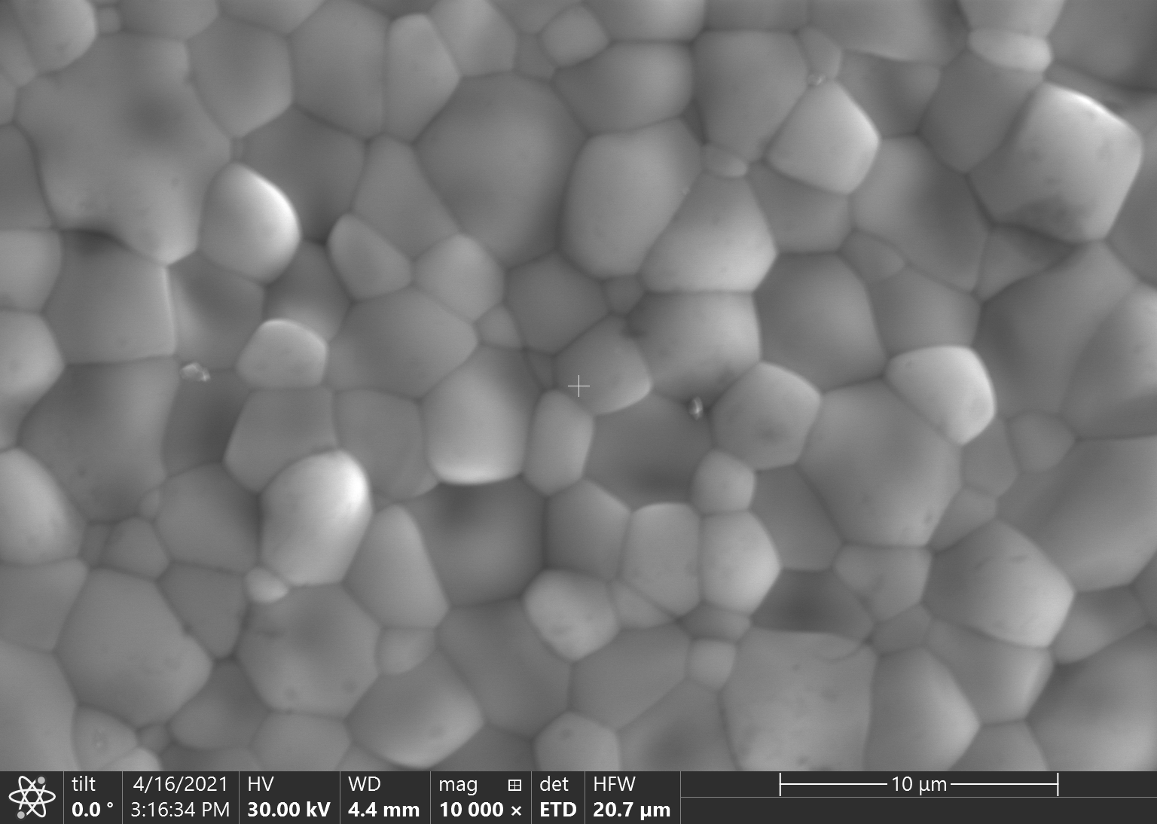
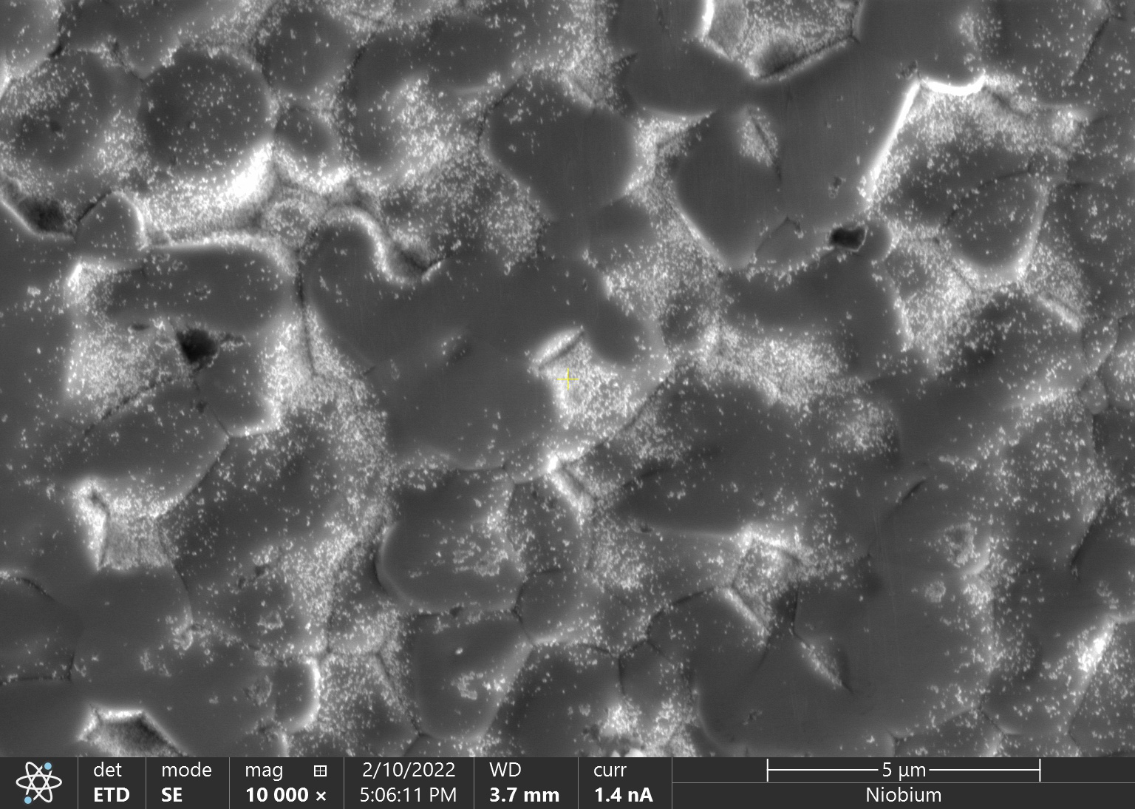
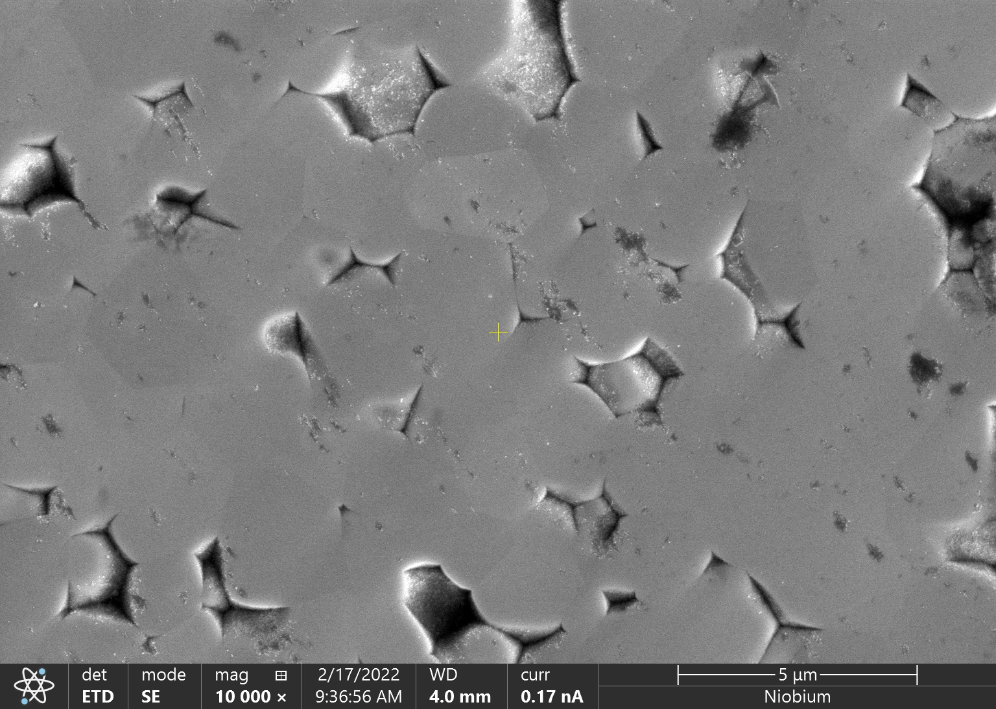
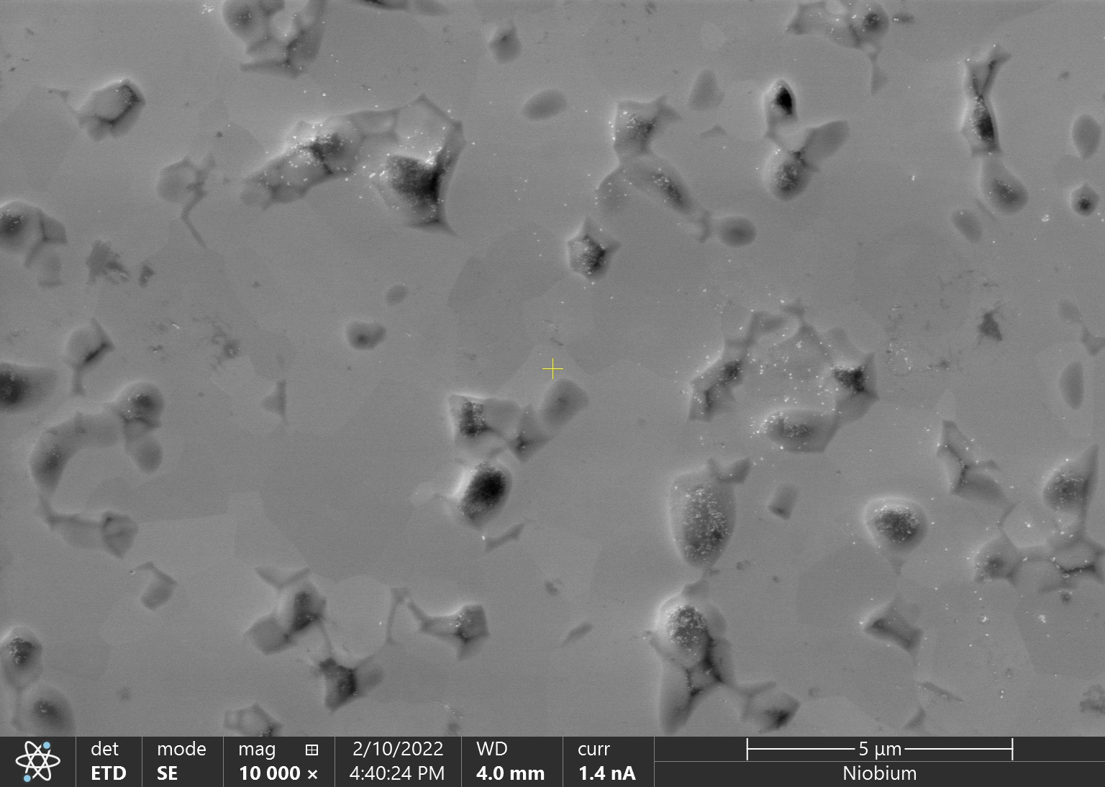
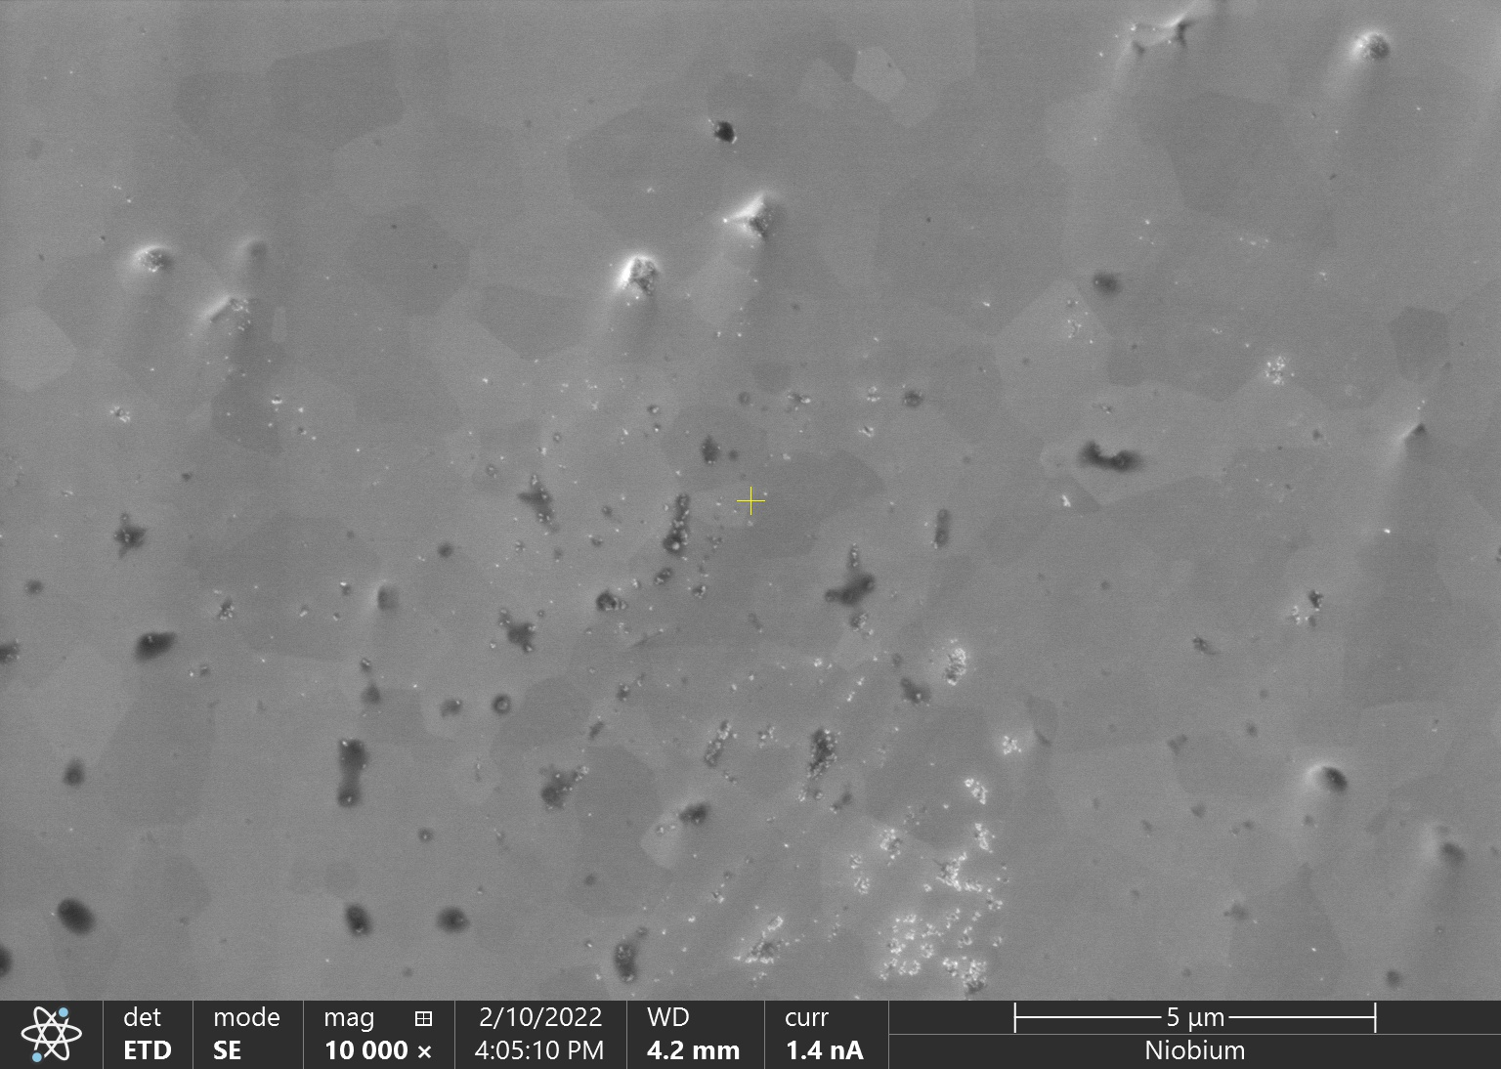
Initial Surface
2 hours
5 μm
5 μm
4 hours
6 hours
8 hours
5 μm
5 μm
5 μm
Viklund, Eric, et al. Superconductor Science and Technology 37.2 (2024): 025009.

Slide 19
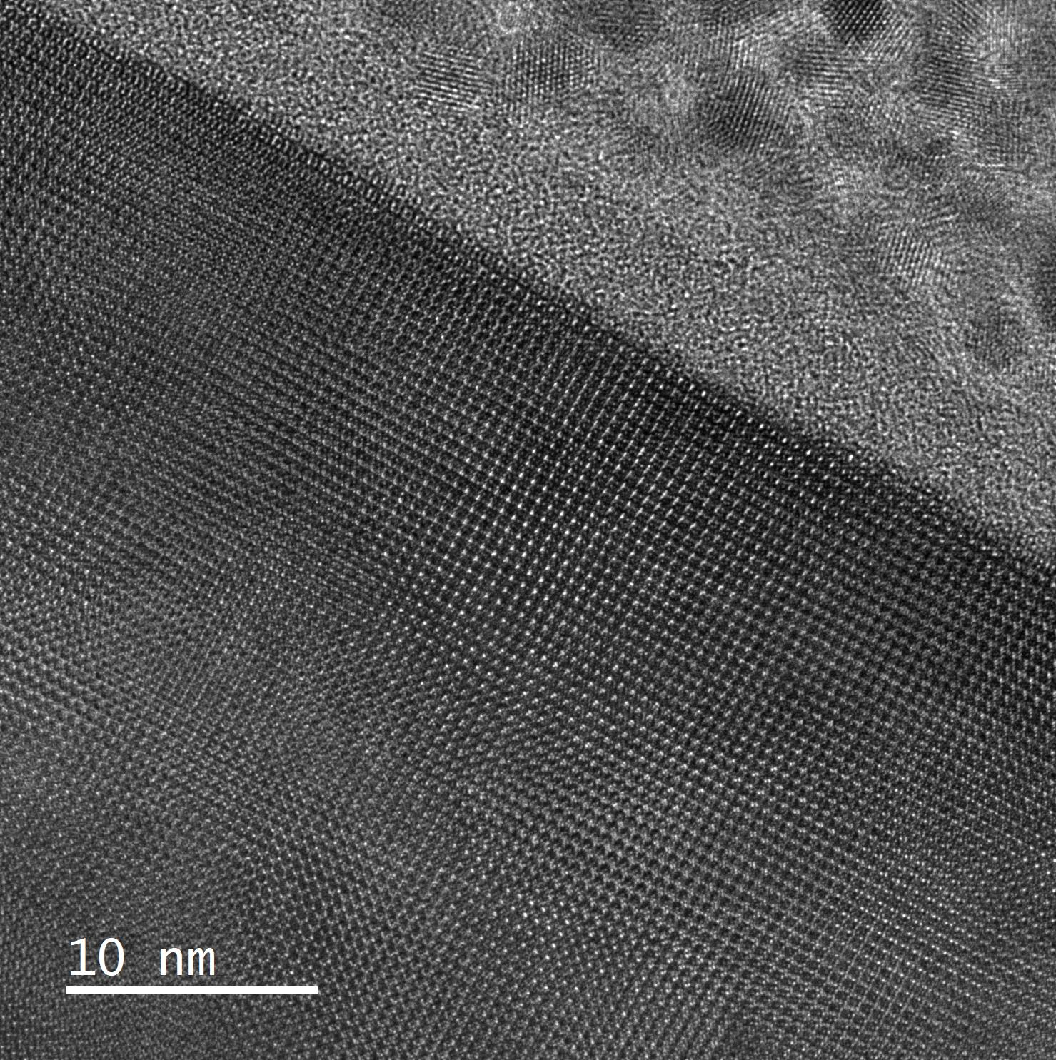
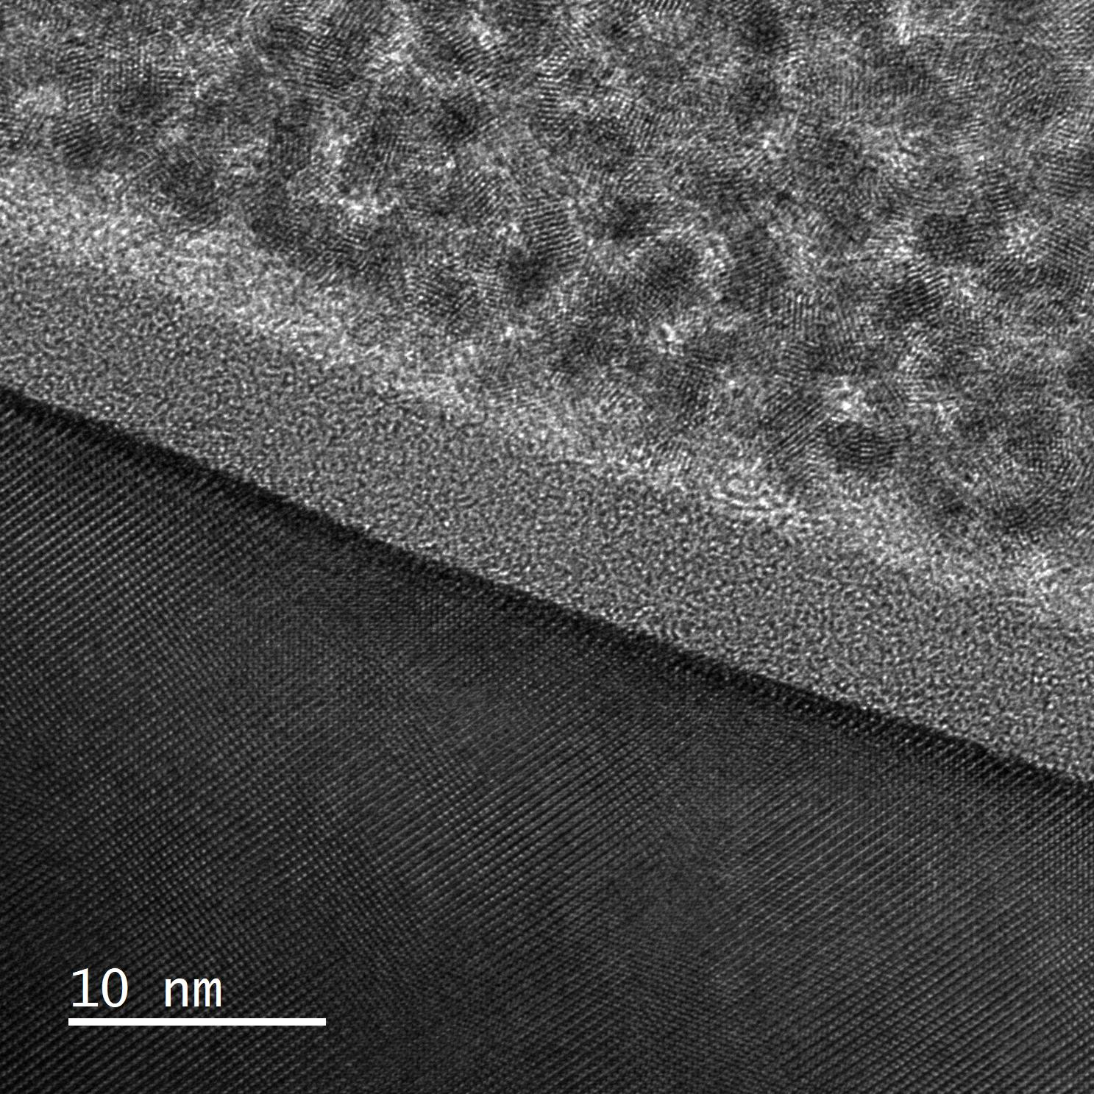
Nanoscale Image of a Polished Nb₃Sn Thin Film
Pt Cap
Pt Cap
Oxide Layer
Oxide Layer
Nb₃Sn
Nb₃Sn
Viklund, Eric, et al. Superconductor Science and Technology 37.2 (2024): 025009.

Slide 20
CBP Surface Roughness and Removal Rate
~170 nm/hr
Typical Niobium Cavity
Viklund, Eric, et al. Superconductor Science and Technology 37.2 (2024): 025009.

Slide 21
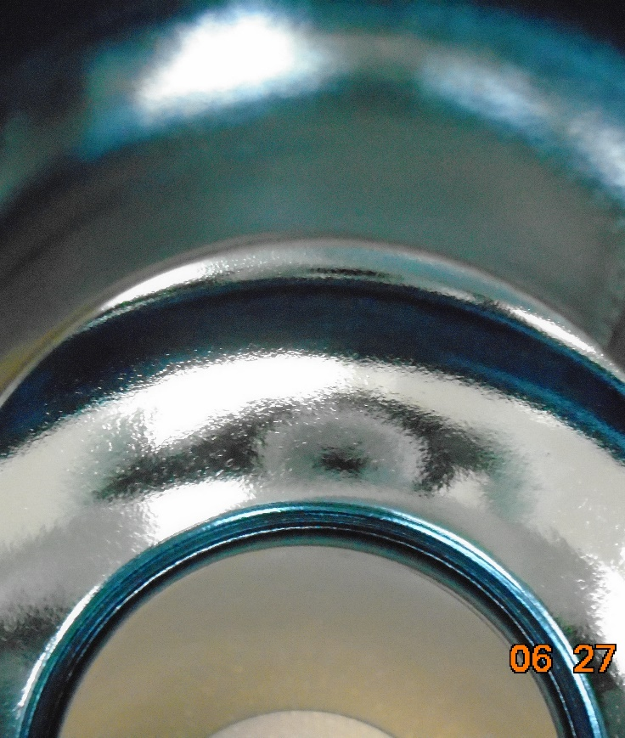
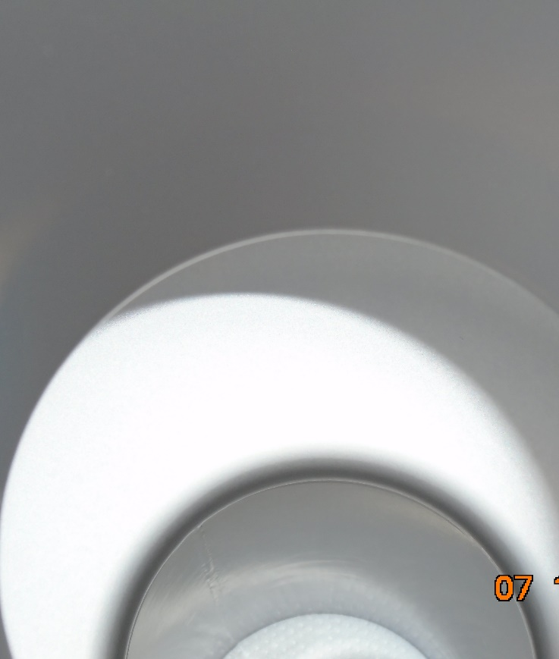
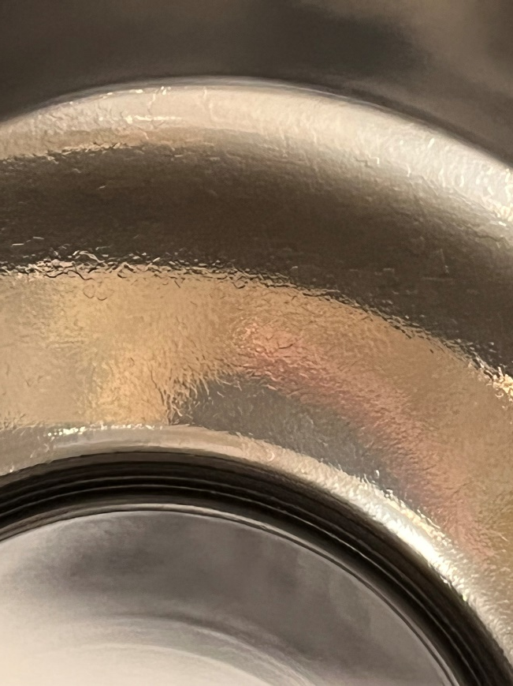
Applying Centrifugal Barrel Polishing (CBP) to a Nb₃Sn Cavity
Before Nb₃Sn Coating
After Nb₃Sn Coating
After Polishing
Nb₃Sn
4-hour CBP

Slide 22
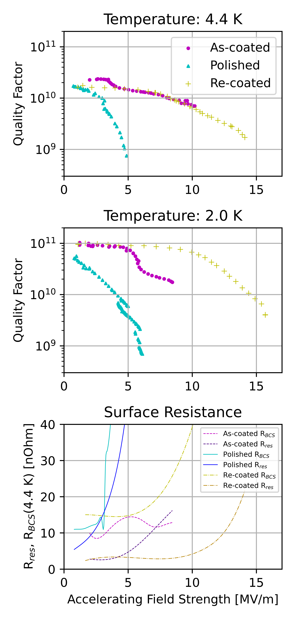
Performance of a Mechanically Polished Nb3Sn SRF Cavity
Polishing initially causes degradation.
A second coating is applied to fix the degradation.
Max accelerating field increases.
10 MV/m to 14 MV/m
Quality factor stays the same.
First successful application of polishing to a Nb₃Sn cavity!
Viklund, Eric, et al. Superconductor Science and Technology 37.2 (2024): 025009.

Slide 23
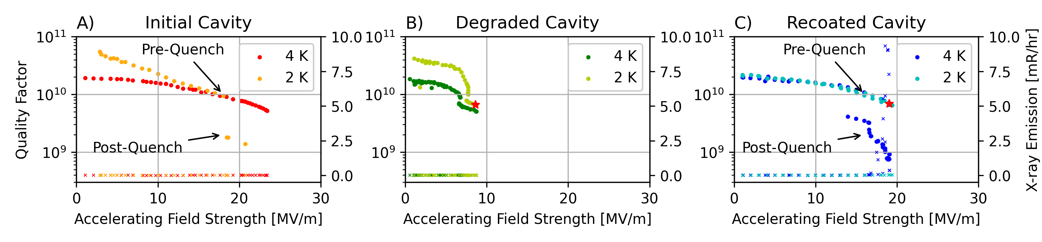
Recoating Heals Degraded Nb₃Sn Cavities
Nb₃Sn cavity performance is degraded by strain.
Tuning
Assembly
Transportation
A second, light coating is required to fix performance.
1200 ℃ → 1000 ℃
5 h → 1 h
4 g of Sn → 0.85 g of Sn

Slide 24
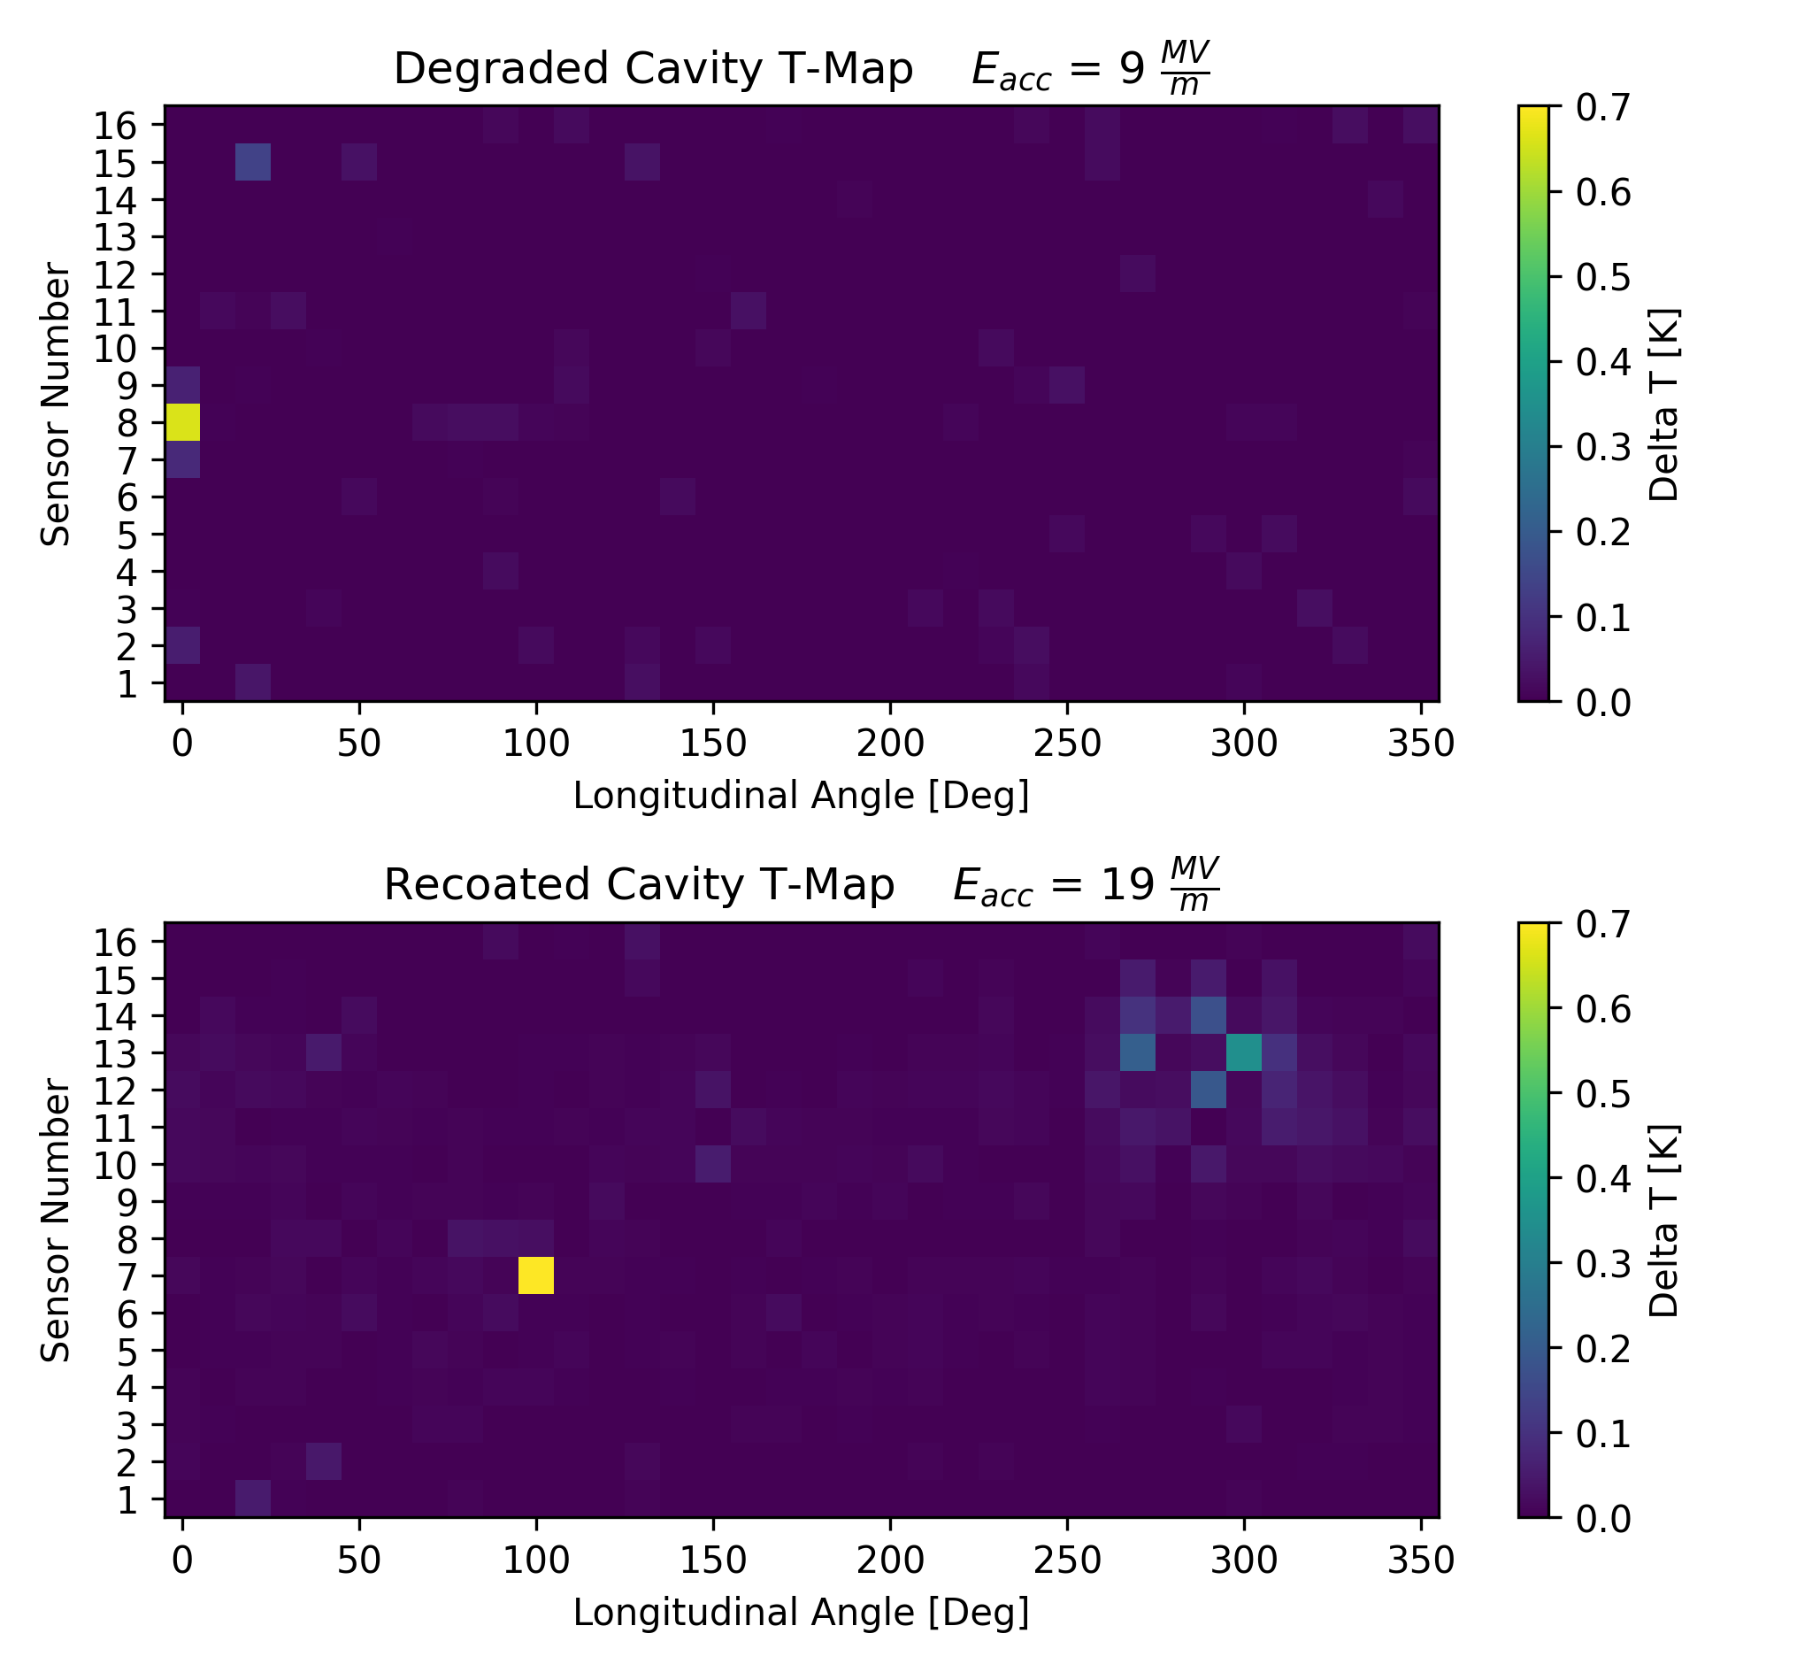
Recoated Cavity T-Map
Degraded cavity equator hotspot.
Recoating heals the defect causing the hotspot.

Slide 25
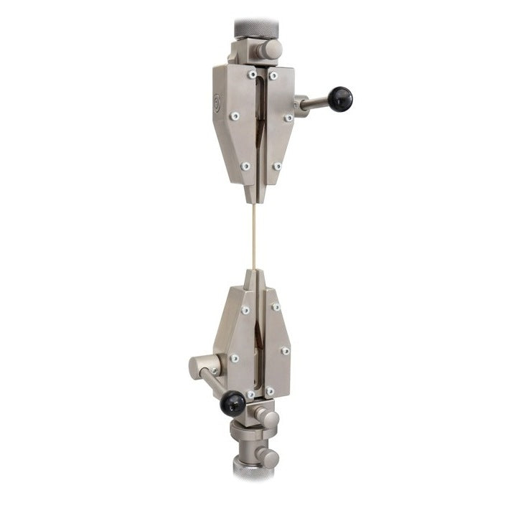
Finding the Mechanism of Nb₃Sn Cavity Healing
Strain applied to cavity causes cracks in Nb₃Sn coating.
Somehow the recoating can repair cracks.
Are the cracks being filled in?
Is the Nb₃Sn coating re-dissolving?
Is the new Nb₃Sn stoichiometric?
Nb₃Sn coated wires are used to study crack formation and healing.
0.1% to 0.5% elongation of the wire causes crack formation.

Slide 26
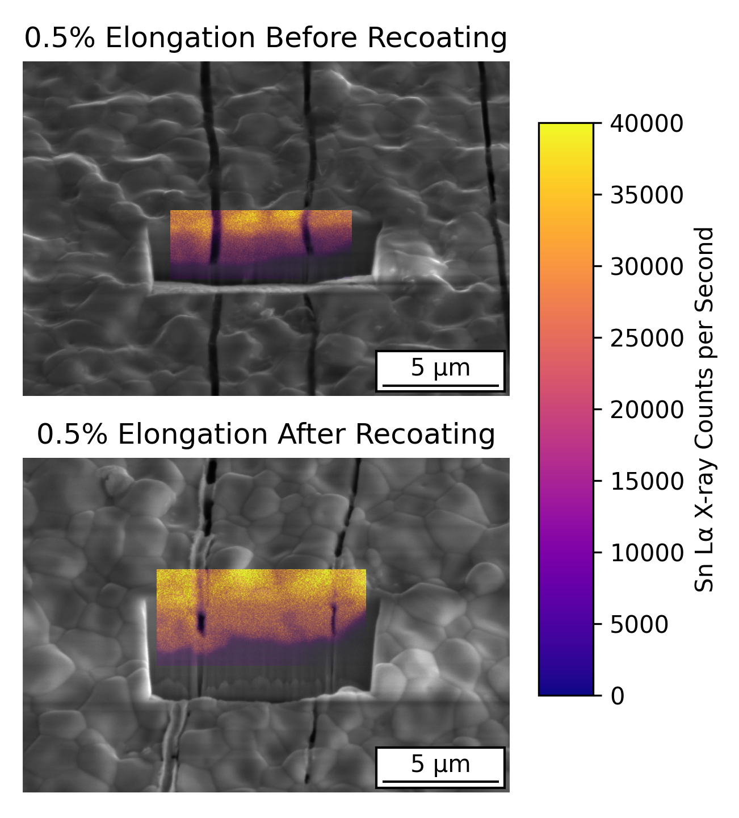
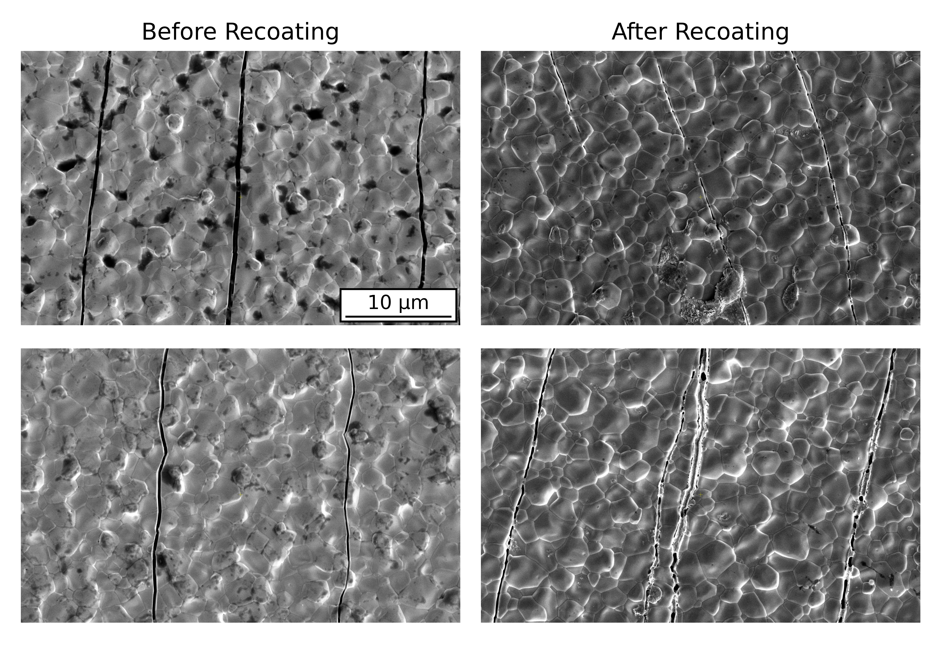
Results of Wire Study
New Nb₃Sn is formed in the crack and at the base of the crack in the Nb substrate.
New material is stoichiometric.

Slide 27
Research Proposal:
SRF Cavity Manufacturing Cost Reduction
Eric Viklund

Slide 28
HF-Free Bipolar Electropolishing
The use of HF in the fabrication of niobium SRF cavities provides a challenge for the large-scale production of cavities.
Environmental impact of large volumes of toxic chemicals used.
Human safety risk of working with toxic chemicals.
Increased costs due to strict safety requirements and procedures.
Cost estimates for electropolishing with HF is $2,934 per cavity.¹
Bipolar electropolishing is a new technique for polishing niobium without using HF acid.
Material removal is achieved by alternating the polarity of the niobium.
Anodic oxidation pulse
Cathodic dissolution of the oxide
Bipolar electropolishing can utilize HF-free electrolytes or even neutral salt-based electrolytes.
1. Taylor, E. J., et al. SRF2015, Whistler, BC, Canada (2015): 359.

Slide 29
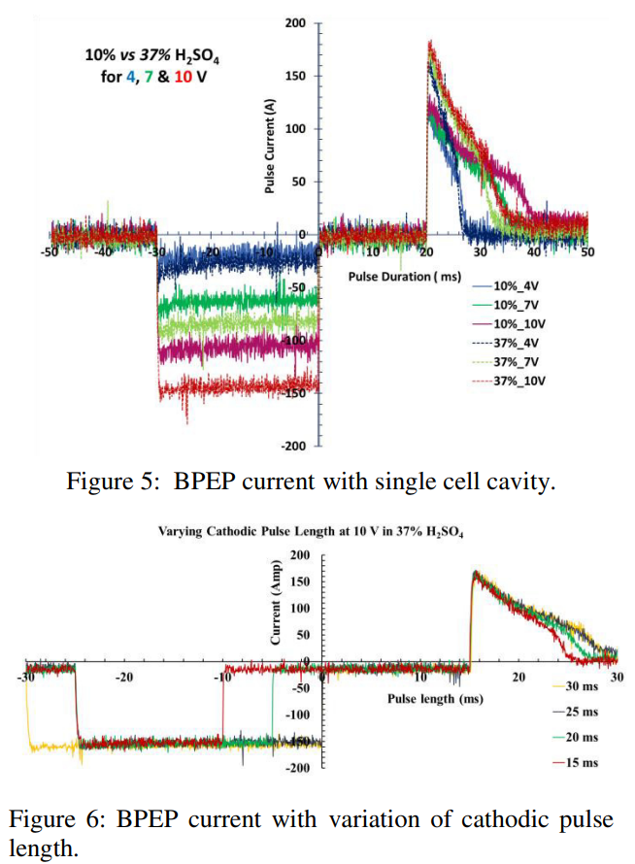
Bipolar Electropolishing Study
Bipolar EP has been shown to be effective by Faraday Technology, Inc., Cornell SRF group, KEK, and Jefferson Lab.
To integrate bipolar electropolishing in large-scale cavity fabrication for the ILC the removal rate must be improved.
120 hours to remove 64 μm¹
Removal rates are currently limited by the power supply.
High currents during voltage pulse
Electrolysis during cathodic pulse
Limited repetition rate
F. Furuta et al., in Proc. 18th Int. Conf. on RF Superconductivity (SRF'17), Lanzhou, China, July 2017, paper TUPB074, pp. 567-570, ISBN: 978-3-95450-191-5, https://doi.org/10.18429/JACoW-SRF2017-TUPB074, 2018.
Tian, Hui, et al. No. JLAB-ACC-18-2836; DOE/OR/23177-4574; TUPO043. Thomas Jefferson National Accelerator Facility (TJNAF), Newport News, VA (United States), 2019.

Slide 30
Plan of Study
Optimize bipolar EP parameters through a sample study
Optimize pulse waveform for high efficiency
Explore different electrolytes, neutral salt electrolytes
Electrochemical impedance spectroscopy will be used to analyze the electrochemical nature of the process to better determine the optimal pulse voltage and duration.
Utilize KEK’s vertical EP capabilities and develop high current pulsed power supply to perform bipolar EP on 1-cell and 9-cell cavities.

Slide 31
Questions

